Slide 1

Securing Resources
Managed Identities
Hybrid Identities
Identity Providers
Data Security
RBAC
Mohd Mishal
Cloud Consultant
MCT

Slide 2
Design Security and Identity Solutions (20%-25%)
Design an identity solution
Design AD Connect synchronization; design federated identities using Active Directory Federation Services (AD FS); design solutions for Multi-Factor Authentication (MFA); design an architecture using Active Directory on-premises and Azure Active Directory (AAD); determine when to use Azure AD Domain Services; design security for Mobile Apps using AAD
Secure resources by using identity providers
Design solutions that use external or consumer identity providers such as Microsoft account, Facebook, Google, and Yahoo; determine when to use Azure AD B2C and Azure AD B2B; design mobile apps using AAD B2C or AAD B2B
Design a data security solution
Design data security solutions for Azure services; determine when to use Azure Storage encryption, Azure Disk Encryption, Azure SQL Database security capabilities, and Azure Key Vault; design for protecting secrets in ARM templates using Azure Key Vault; design for protecting application secrets using Azure Key Vault; design a solution for managing certificates using Azure Key Vault; design solutions that use Azure AD Managed Service Identity
Design a mechanism of governance and policies for administering Azure resources
Determine when to use Azure RBAC standard roles and custom roles; define an Azure RBAC strategy; determine when to use Azure resource policies; determine when to use Azure AD Privileged Identity Management; design solutions that use Azure AD Managed Service Identity; determine when to use HSM-backed keys
Manage security risks by using an appropriate security solution
Identify, assess, and mitigate security risks by using Azure Security Center, Operations Management Suite Security and Audit solutions, and other services; determine when to use Azure AD Identity Protection; determine when to use Advanced Threat Detection; determine an appropriate endpoint protection strategy
Notes:
STU TEAMS
E.G. APPS AND IDENTITY
https://www.microsoft.com/en-us/learning/exam-70-535.aspx

Slide 3
Secure resources by using managed identities
Notes:
IDENTITY IS THE CONTROL PLANE FOR THE CLOUD
How do we identify, authenticate, and authorize users within Azure?
How do we manage who may access to our Azure resources?

Slide 4
On-Premise Active Directory vs Azure AD
Active Directory On-Premise | Azure AD
Authentication Provider | Authentication Provider
Internal single customer directory service | Multi-customer public directory service
Hierarchical structure of: Users, Computers, Ous, Groups, Services | Flat structure of: Users and Groups
Group Policy and DNS data | NA
Can be accessed using LDAP | Can be accessed using Graph API
Primarily uses Kerberos for authentication | Authentication can use SAML, WS-Federation and Oauth
Can Join VM and computer to domain | Can’t join VMs and computer(Except Windows 10)
AD DS Forest, Trees, Domains e.g cloudapp.net | Azure AD Tenants eg. Contoso.onmicrosoft.com
Notes:
AADDS—we won’t speak about
In MS Marketing Speak: “Azure Active Directory (Azure AD) is a comprehensive identity and access management cloud solution that gives you a robust set of capabilities to manage users and groups. It helps secure access to on-premises and cloud applications, including Microsoft web services like Office 365, and many non-Microsoft software as a service (SaaS) applications.”
Azure AD is not the same as AD Directory Services – ADDS (a.k.a. On-Prem AD)
Azure AD does not…
Support Group Policy
Support Organizational Units or Computer objects
Support forests or trusts
Flat structure of users and groups
serves as the foundation of Azure’s authentication and authorization functionality
Think UNIX /etc/passwd and /etc/group files
Azure ADDS does exist but is outside the scope of this presentation

Slide 5
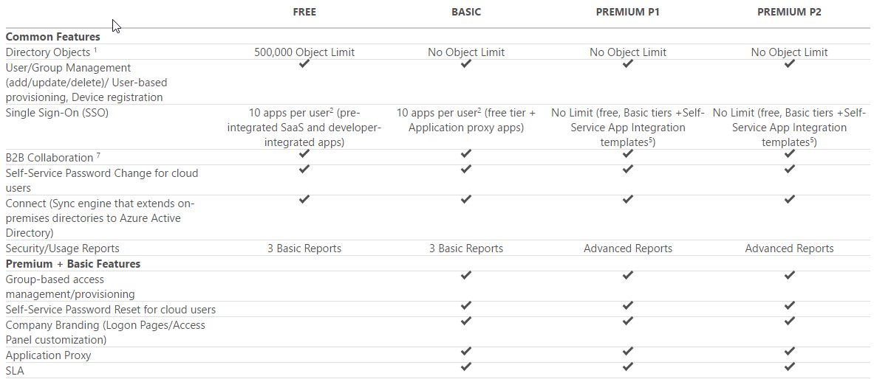
Azure AD Edition Features
https://azure.microsoft.com/en-us/pricing/details/active-directory/
Notes:
WHEN CUSTOMER SUBSCRIBES TO O365, MICROSOFT PROVISIONS AN AZURE INSTANCE AS WELL, IN THE FREE TIER
4 ”editions” of AzureAD
Free is included with any Azure subscription, but you can add paid capabilities using the Azure Active Directory Basic, Premium P1, and Premium P2 editions.
Azure Active Directory Basic
Designed for task workers with cloud-first needs
Provides cloud centric application access and self-service identity management solutions
Azure Active Directory Application Proxy (to publish on-premises web applications using Azure Active Directory
SLA of 99.9 percent uptime.
Azure Active Directory Premium P1
Designed to empower organizations with more demanding identity and access management needs
Adds feature-rich enterprise-level identity management capabilities
Enables hybrid users and seamless on-premises and cloud access
Microsoft Identity Manager (an on-premises identity and access management suite)
Provides cloud write-back capabilities enabling solutions like self-service password reset for your on-premises users.
Azure Active Directory Premium P2
Designed with advanced protection for all your users and administrators
Adds Identity Protection and Privileged Identity Management
Leverages billions of signals to provide risk-based conditional access to your applications and critical company data
Test focuses on what is available in the different offerings/SKUs.
As an architect it’s important to know the application/solution requirements and select the proper edition
Know what features/functionality is included by specific levels/editions
You don’t want to buy Premium “just because”
So what are the differences?
Reference(s):
https://azure.microsoft.com/en-us/pricing/details/active-directory/
https://docs.microsoft.com/en-us/azure/active-directory/active-directory-whatis

Slide 6
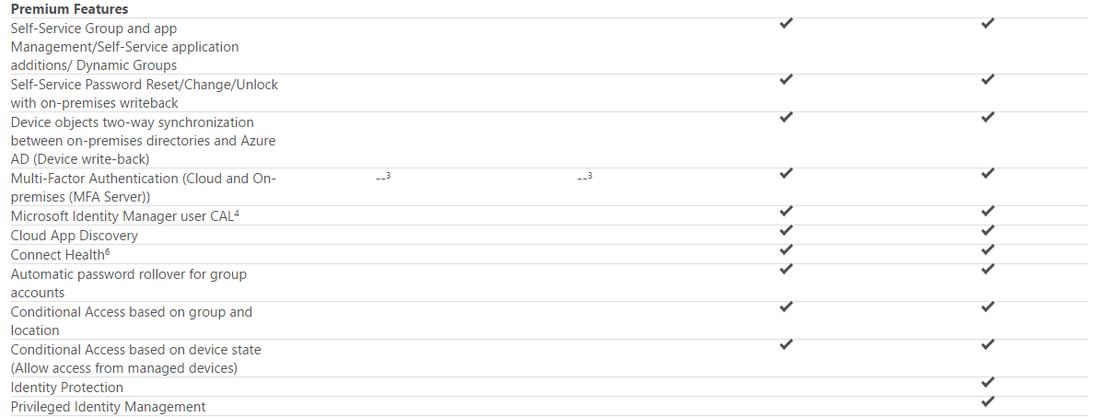
Azure AD Premium Features
https://azure.microsoft.com/en-us/pricing/details/active-directory/
Notes:
ENABLE ACCESS TO AZURE PORTAL BY REQUIRING MFA
Periodic requirement to justify continued administrative access.
Biggest difference between the Premium offerings is the inclusion of Identity Protection and Privileged Identity Management in P2
Know the difference between Basic and Premium
Must be able to answer “what edition supports _____ “
Multiple selections
Reference(s):
https://azure.microsoft.com/en-us/pricing/details/active-directory/

Slide 7
Which Azure AD editions provide self service password reset?
Free
Basic
Premium

Slide 8
Which Azure AD editions provide self service password reset?
Basic
Premium

Slide 9
Access Azure AD using Graph API
REST API endpoints (OData 3.0 compliant)
Supports common CRUD operations:
Create a new user in a directory
Get a user’s detailed properties
Update a user’s properties
Check a user’s group membership for role-based access
Disable a user’s account or delete it entirely
NOTE: Microsoft Graph is the next up and coming way to do this
Notes:
Azure Active Directory Graph API
https://docs.microsoft.com/en-us/azure/active-directory/develop/active-directory-graph-api
Get started with Azure Active Directory Identity Protection and Microsoft Graph
https://docs.microsoft.com/en-us/azure/active-directory/active-directory-identityprotection-graph-getting-started
Blog post on MS Graph vs AAD Graph
https://dev.office.com/blogs/microsoft-graph-or-azure-ad-graph
Microsoft Graph or the Azure AD Graph
https://dev.office.com/blogs/microsoft-graph-or-azure-ad-graph
**AAD Graph will remain available and receive bugfixes for the foreseeable future**
NOTE: For existing applications that already use Azure AD Graph, nothing changes and it's business as usual. The Azure AD Graph GA endpoint will remain fully available for all applications including production applications. We will continue to closely monitor this API, fix service issues and strive to continue to provide 99.99% service availability.

Slide 10
Steps to using Graph API
Three steps to accessing Microsoft Graph API
Add application with a client secret
Use secret and other info to authenticate to Graph API and get token
Use returned token to make requests to the API endpoint
https://graph.windows.net/{tenantId}/{resourcePath}?{apiVersion}
Notes:
Programmatically access Azure AD using Graph API
Operations overview | Graph API concepts
https://msdn.microsoft.com/Library/Azure/Ad/Graph/howto/azure-ad-graph-api-operations-overview
Graph API reference
https://msdn.microsoft.com/Library/Azure/Ad/Graph/api/api-catalog

Slide 11
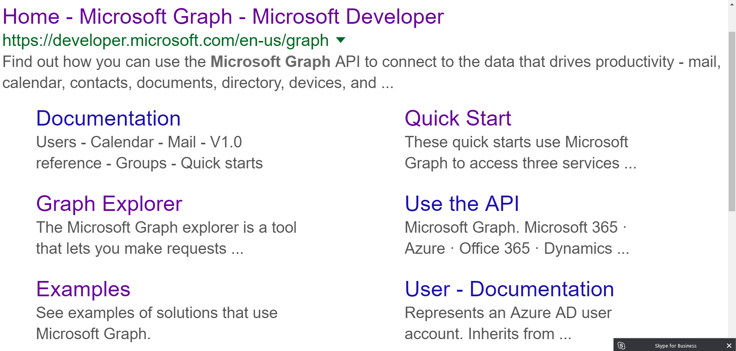

Slide 12
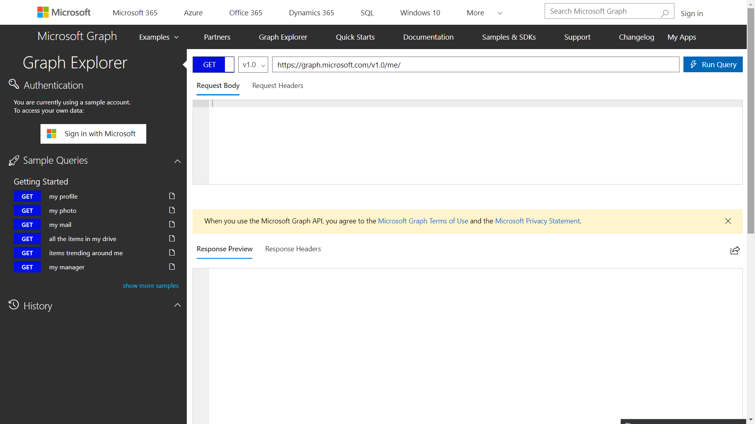

Slide 13
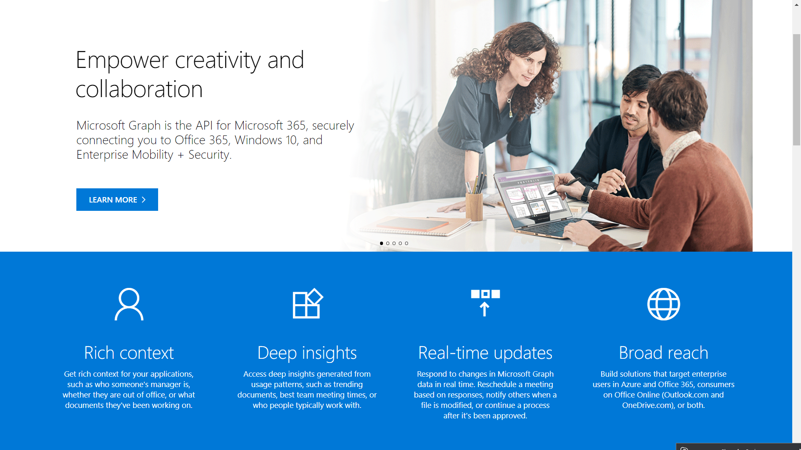
Notes:
https://developer.microsoft.com/en-us/graph

Slide 14
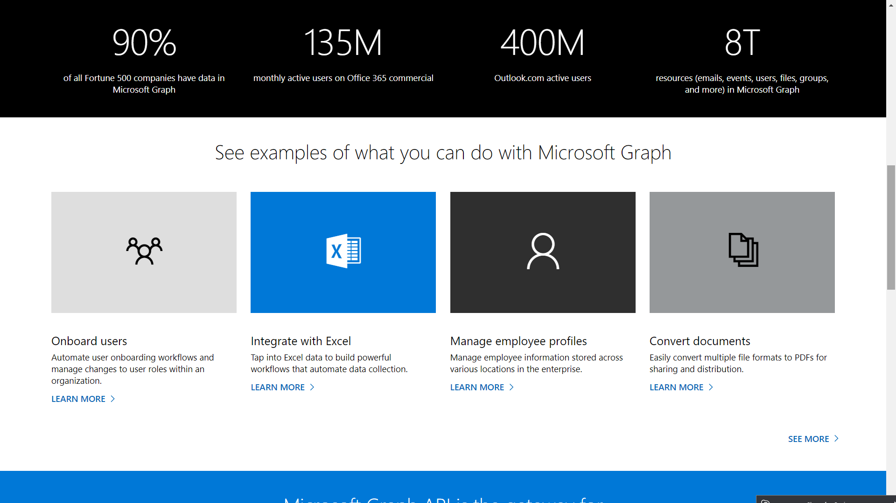

Slide 15
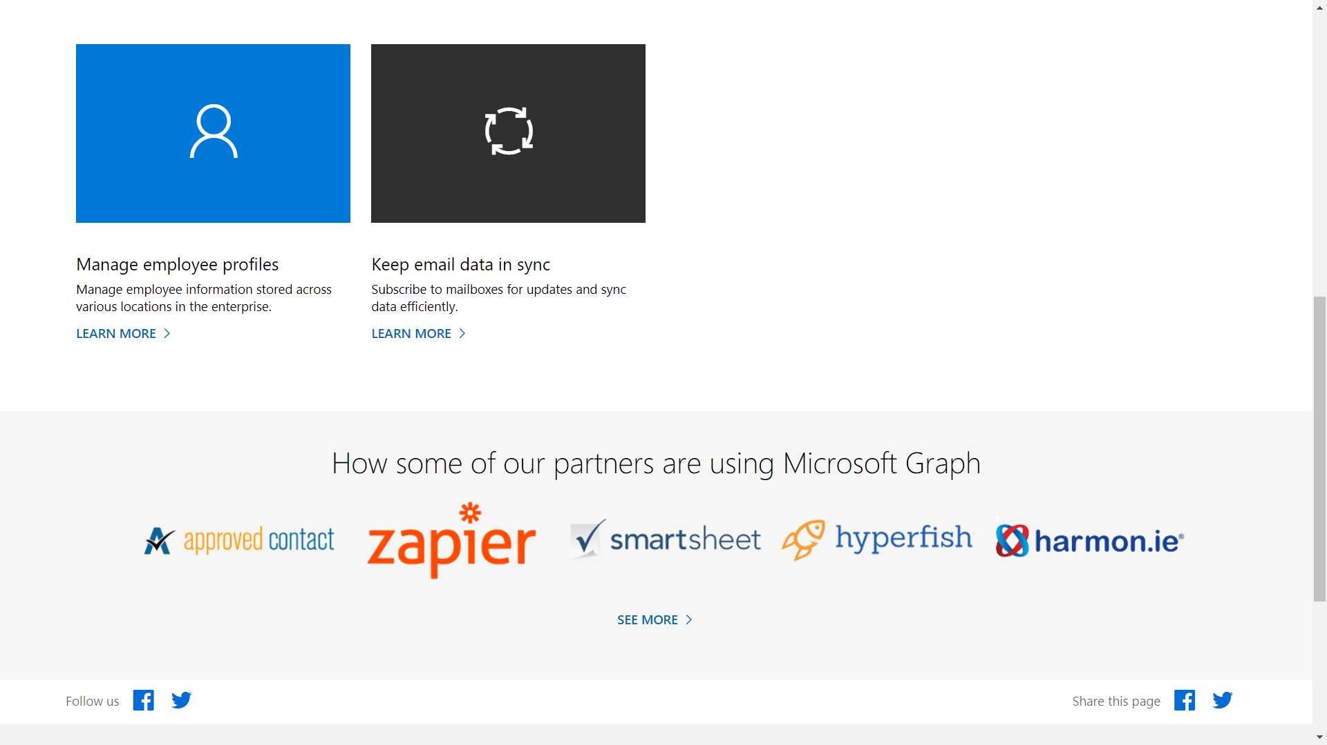

Slide 16
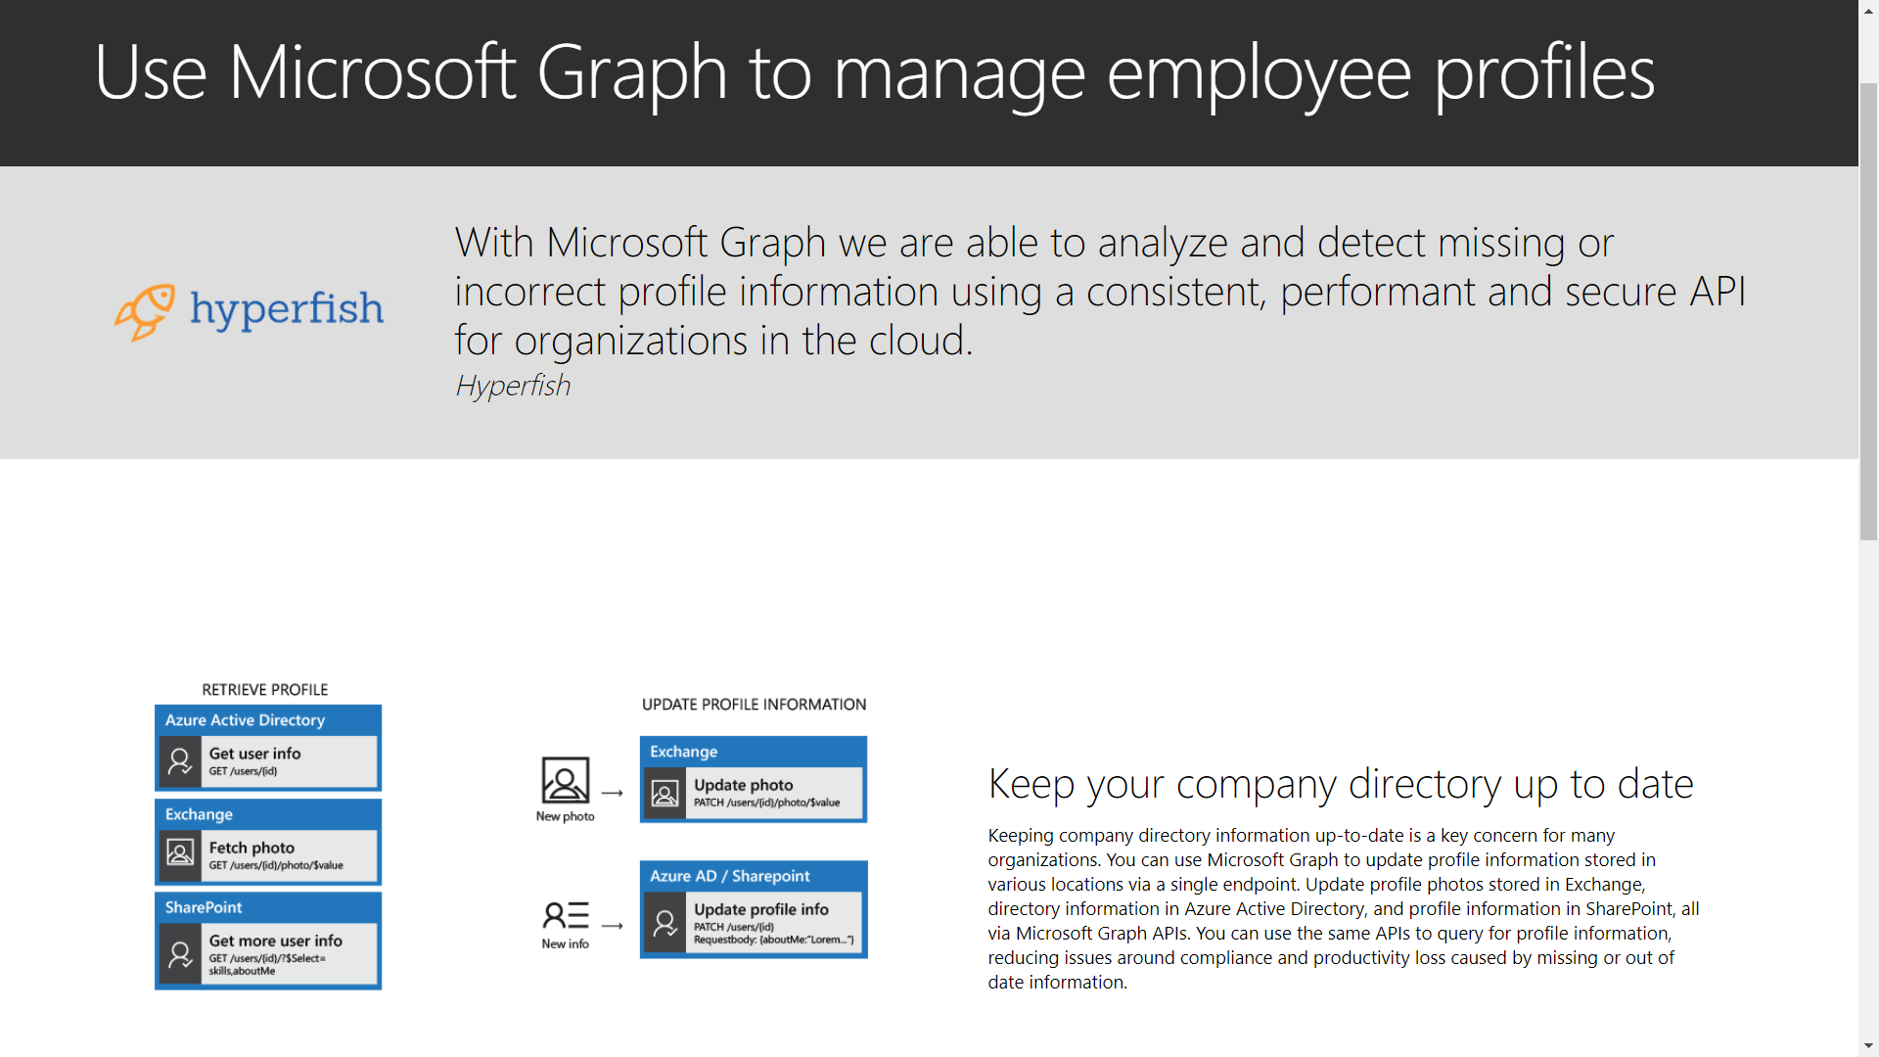

Slide 17
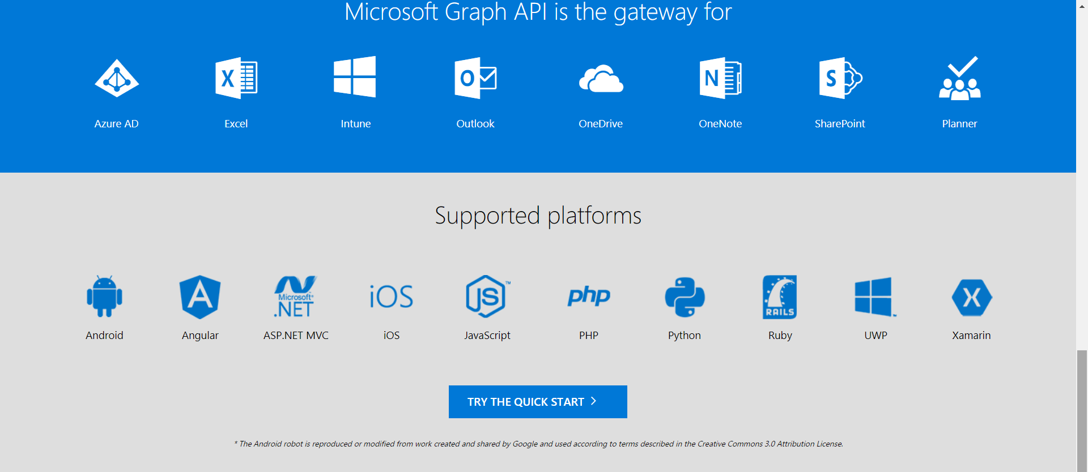

Slide 18
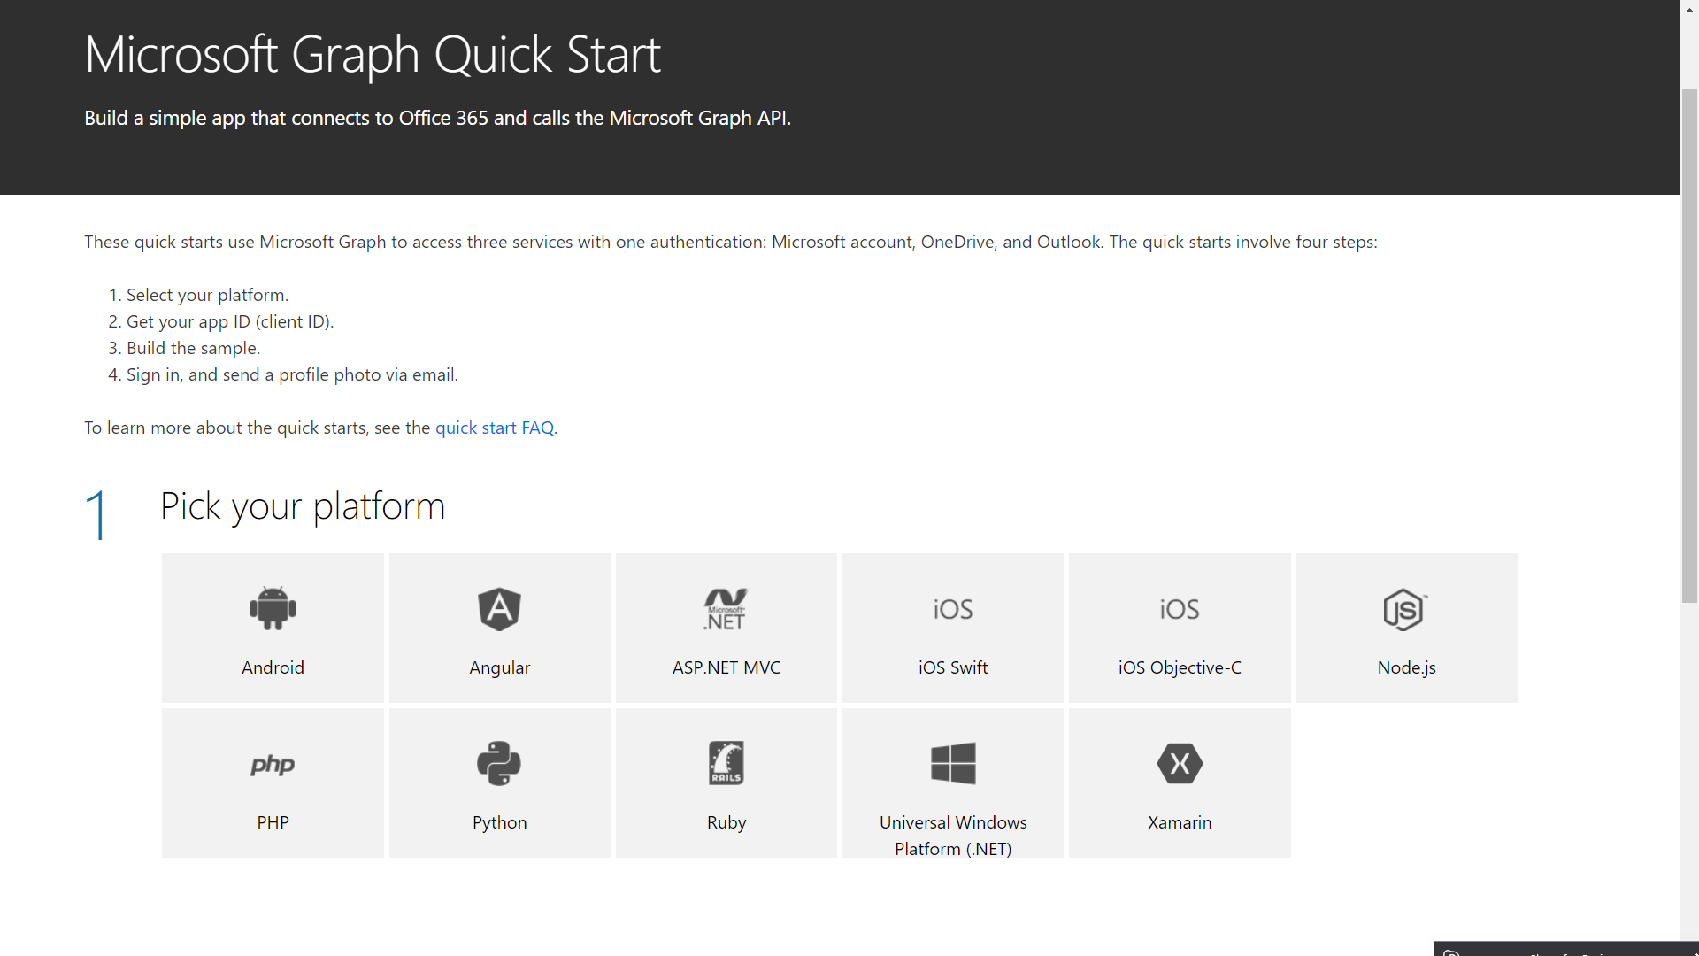

Slide 19
Which of the following are needed to interact with the Graph API?
Access Token
The Azure AD Application Key
The Azure AD Tenant ID
Refresh Token
Notes:
Question

Slide 20
Which of the following are needed to interact with the Graph API?
Access Token
The Azure AD Application Key
The Azure AD Tenant ID
Notes:
Answer: 1, 2, 3

Slide 21
OAuth 2.0 and OpenID Connect
OAuth 2.0
Open standard for authorization
Implemented as an authorization protocol versus an authentication protocol
Focused on what resources you have access to
OpenID Connect
Extends the OAuth 2.0 authorization protocol to use as an authentication protocol
Enables SSO with Oauth
Recommended for web applications hosted on a server and accessed via a browser
https://docs.microsoft.com/en-us/azure/active-directory/develop/active-directory-v2-protocols
Notes:
Subsection: Secure access to resources from Azure AD applications using OAuth and OpenID Connect
OpenID Connect is a simple identity layer built on top of the OAuth 2.0 protocol. OAuth 2.0 defines mechanisms to obtain and use access tokens to access protected resources, but they do not define standard methods to provide identity information. OpenID Connect implements authentication as an extension to the OAuth 2.0 authorization process.
OAuth spec
https://tools.ietf.org/html/rfc6749#section-4.1
OpenID spec
http://openid.net/specs/openid-connect-core-1_0.html
OpenID Connect Hybrid Flow and IdentityServer v3
https://leastprivilege.com/2014/10/10/openid-connect-hybrid-flow-and-identityserver-v3/
https://docs.microsoft.com/en-us/azure/active-directory/develop/active-directory-authentication-scenarios

Slide 22
Auth* Terms
client refers to the mobile app, web app, etc. that wants to access a resource
resource owner has control of resources that are being secured
security token is a collection of claims. It is often digitally signed, encrypted, and transferred through secured channels to ensure its conﬁdentiality, integrity, and authenticity (aka access token)
service provider provides requested services (aka relying party)
identity provider authenticates entities and issues security tokens to relying parties (aka security token service STS or authorization server AS)
authentication is to verify if an entity is indeed what it claims to be
authorization is the process of determining whether an authenticated user has access to certain functionalities provided by the service provider
claim is an assertion made on an attribute of an entity (think property or descriptor or attribute)
refresh token is optionally issued with the access token and is a longer lasting credential (than the access token) solely used to request additional access tokens.
identity token or id token is OpenID’s extension to OAuth 2. The structure is similar to the access token, but indicates user authentication -not authorization. (aka authorization token)
Notes:
Subsection: Secure access to resources from Azure AD applications using OAuth and OpenID Connect
Define Authentication and Authorization
Authorize access to web applications using OAuth 2.0 and Azure Active Directory
https://docs.microsoft.com/en-us/azure/active-directory/develop/active-directory-protocols-oauth-code
Azure AD Code Samples
https://azure.microsoft.com/en-us/resources/samples/?service=active-directory
Integrate Azure AD into a web application using OpenID Connect
https://azure.microsoft.com/en-us/resources/samples/active-directory-dotnet-webapp-openidconnect/

Slide 23
Important OAuth Flows
Authorization Code Flow
The Authorization Code Flow returns an Authorization Code to the Client, which can then exchange it for an ID Token and an Access Token directly.
Implicit Flow
The Implicit Flow is mainly used by Clients implemented in a browser using a scripting language. The Access Token and ID Token are returned directly to the Client.
Hybrid Flow
The Hybrid Flow, some tokens are returned from the Authorization Endpoint and others are returned from the Token Endpoint.
https://docs.microsoft.com/en-us/azure/active-directory/develop/active-directory-v2-protocols-implicit
Notes:
Once you've authenticated with OpenID Connect, you use OAuth flows to gain authorization tokens for resources.
OAuth specifies different authorization flows:
Authorization
Best used server side or with native apps
Use when unable to establish session cookie with Azure AD
Client code is given Authorization Code which can be used to request ID Tokens/AccessTokens
Implicit
Use if planning an SPA architecture, have no backend components or intend to invoke a Web API via JavaScript
Requires ability to establish (and maintain) session cookie with Azure AD
Client code is NOT given authorization Code
Hybrid
Combination of above; most flexible
Allows request of Identity token, access token, and access code via front channel using
a redirect (for native and JS clients)
HTML form POST (for server-based apps)
Returns Identity token for immediate use by client app
Returns Authorization code for use by backend to obtain long-lived access to resources
Reference(s)
OAuth spec
https://tools.ietf.org/html/rfc6749#section-4.1
OpenID spec
http://openid.net/specs/openid-connect-core-1_0.html
OpenID Connect Hybrid Flow and IdentityServer v3
https://leastprivilege.com/2014/10/10/openid-connect-hybrid-flow-and-identityserver-v3/

Slide 24
Authorization Code Flow
Notes:
Best for native applications calling web api…
Requires user interaction!!!
Q: Has anyone seen/used this before?
A: Powershell Azure RM CLI login-azurermaccount
Reference(s):
https://docs.microsoft.com/en-us/azure/active-directory/develop/active-directory-authentication-scenarios#native-application-to-web-api

Slide 25
Implicit Flow
Notes:
Single Page Applicationi flow
Reference(s):
https://docs.microsoft.com/en-us/azure/active-directory/develop/active-directory-authentication-scenarios#single-page-application-spa

Slide 26
Secure Using OAuth and OpenID Connect
app.UseOpenIdConnectAuthentication(
new OpenIdConnectAuthenticationOptions
{
ClientId = clientId, // The Client ID uniquely identifies application to Azure AD.
Authority = Authority,//https://login.microsoftonline.com/{tenantId} Sign-in URL of tenant
PostLogoutRedirectUri = redirectUri,
RedirectUri = redirectUri, // Redirect Uri is the URL where the user will be redirected
// NOTE: handlers are in order of when they get called
Notifications = new OpenIdConnectAuthenticationNotifications()
{
RedirectToIdentityProvider = OnRedirectToIdentityProvider,
MessageReceived = OnMessageReceived,
SecurityTokenReceived = OnSecurityTokenReceived,
SecurityTokenValidated = OnSecurityTokenValidated,
AuthorizationCodeReceived = OnAuthorizationCodeReceived,
AuthenticationFailed = OnAuthenticationFailed
}
});
Notes:
Secure access to resources from Azure AD applications using OAuth and OpenID Connect
Authorize access to web applications using OpenID Connect and Azure Active Directory
https://docs.microsoft.com/en-us/azure/active-directory/develop/active-directory-protocols-openid-connect-code
Authorize access to web applications using OAuth 2.0 and Azure Active Directory
https://docs.microsoft.com/en-us/azure/active-directory/develop/active-directory-protocols-oauth-code
Azure AD Code Samples
https://azure.microsoft.com/en-us/resources/samples/?service=active-directory
Integrate Azure AD into a web application using OpenID Connect
https://azure.microsoft.com/en-us/resources/samples/active-directory-dotnet-webapp-openidconnect/

Slide 27
When using OAuth and OpenID Connect, which notification handler will you know the user is a valid logged in Azure AD user?
RedirectToIdentityProvider
MessageReceived
SecurityTokenReceived
SecurityTokenValidated
AuthorizationCodeReceived
AuthenticationFailed

Slide 28
When using OAuth and OpenID Connect, which notification handler will you know the user is a valid logged in Azure AD user?
AuthorizationCodeReceived
Notes:
Answer: 5

Slide 29
Quite a few components participate in an authentication and authorization workflow. Understanding how they interact with one another is the key to a successful implementation.

Slide 30
Secure resources by using hybrid identities
Notes:
How do we integrate our on-prem AD infrastructure with Azure?
How do we manage our on-prem users and our Azure users?

Slide 31
Azure AD Connect
Connects your on-prem AD infrastructure to Azure
Composed of 3 components
Sync Services
Replicates user/group information between On-Prem and Azure
ADFS (optional)
Addresses complex deployments, such as domain join SSO, enforcement of AD sign-in policy, and smart card or 3rd party MFA.
Health
Robust monitoring and provide a central location to view activity
Notes:
Azure AD Connect is the umbrella technology/name for the components that connect your on-prem AD infrastructure to Azure.
Basically it integrates your on-premises directories with Azure Active Directory, thus providing a common identity for users of Office 365, Azure, and 3rd party SaaS applications with Azure AD Integration.
3 Components:
Synchronization - This component is responsible for creating users, groups, and other objects. It is also responsible for making sure identity information for your on-premises users and groups is matching the cloud.
ADFS (optional) - ADFS stands for Active Directory Federation Services and is an optional part of Azure AD Connect. Federating Azure with an on-prem ADFS environment allows organizations to address complex deployments and provides more granular security controls such as password policies, scheduled login times, or smart card/3rd party MFA.
Health Monitoring - Azure AD Connect Health can provide robust monitoring and provide a central location in the Azure portal to view this activity. For additional information, see Azure Active Directory Connect Health.
Reference(s):
https://docs.microsoft.com/en-us/azure/active-directory/connect/active-directory-aadconnect
https://docs.microsoft.com/en-us/azure/active-directory/connect/active-directory-aadconnectsync-whatis
https://docs.microsoft.com/en-us/azure/active-directory/connect/active-directory-aadconnect-topologies
https://docs.microsoft.com/en-us/azure/active-directory/active-directory-hybrid-identity-design-considerations-tools-comparison
https://docs.microsoft.com/en-us/azure/active-directory/connect/active-directory-aadconnectsync-feature-scheduler

Slide 32
Azure AD Connect
Notes:
Azure AD Connect replaces older versions of identity integration tools such as DirSync, Azure AD Sync, and Forefront Identity Manager with the Azure Active Directory Connector
Windows Azure Active Directory Sync (DirSync) Azure AD Sync are now deprecated and have reached end of support.

Slide 33

Azure AD Connect
Notes:
Depiction of a basic AD connect deployment/topology
More complex deployments are possible
Note Azure AD Connect Topologies
Reference(s):
https://docs.microsoft.com/en-us/azure/active-directory/connect/active-directory-aadconnectsync-whatis
https://docs.microsoft.com/en-us/azure/active-directory/connect/active-directory-aadconnect-topologies
https://docs.microsoft.com/en-us/azure/active-directory/connect/active-directory-aadconnect
https://docs.microsoft.com/en-us/azure/active-directory/active-directory-hybrid-identity-design-considerations-tools-comparison
https://docs.microsoft.com/en-us/azure/active-directory/connect/active-directory-aadconnectsync-feature-scheduler

Slide 34
Azure AD Connect w/ADFS
Simplicity and consistency
Use the same set of APIs and patterns to enable sign on
Use the same set of libraries you can already use to authenticate users against Azure AD
Flexibility
In addition to standard user authorization, enable more complex scenarios
Industry support
OAuth 2.0 and OpenID Connect enjoy wide utilization across the industry, so knowledge of these patterns will help you enable authentication and authorization outside of an Active Directory environment as well
Notes:
ADFS is an extension/add-on to ADDS allowing you to use your on-prem AD as a standards-compliant identity provider. Thus your on-prem AD would serve as the source of truth for user identity.
Simplicity and consistency
Use the same set of APIs and patterns to enable sign on for:
multiple types of applications (server, desktop, mobile, browser)
multiple platforms (android, iOS, Windows)
applications inside the corporate network or hosted in the cloud
Use the same set of libraries you can already use to authenticate users against Azure AD
Flexibility
In addition to standard user authorization, enable more complex scenarios such as:
3-legged sign on flows in which a user authorizes one web application or service to access resources that reside with another web app or service.
Server-to-server flows in which a mid-tier service accesses a back end API
JavaScript based single-page applications (SPA)
Improved security controls
password policies
login time enforcement
However because it’s on-prem, it moves the management burden to your IT Staff. They must provision hardware, software, and consider Availability/DR.
Of course, you could deploy ADFS in Azure itself as long as there aren’t any network or security policies preventing it.
Reference(s):
https://docs.microsoft.com/en-us/azure/active-directory/connect/active-directory-aadconnectfed-whatis

Slide 35
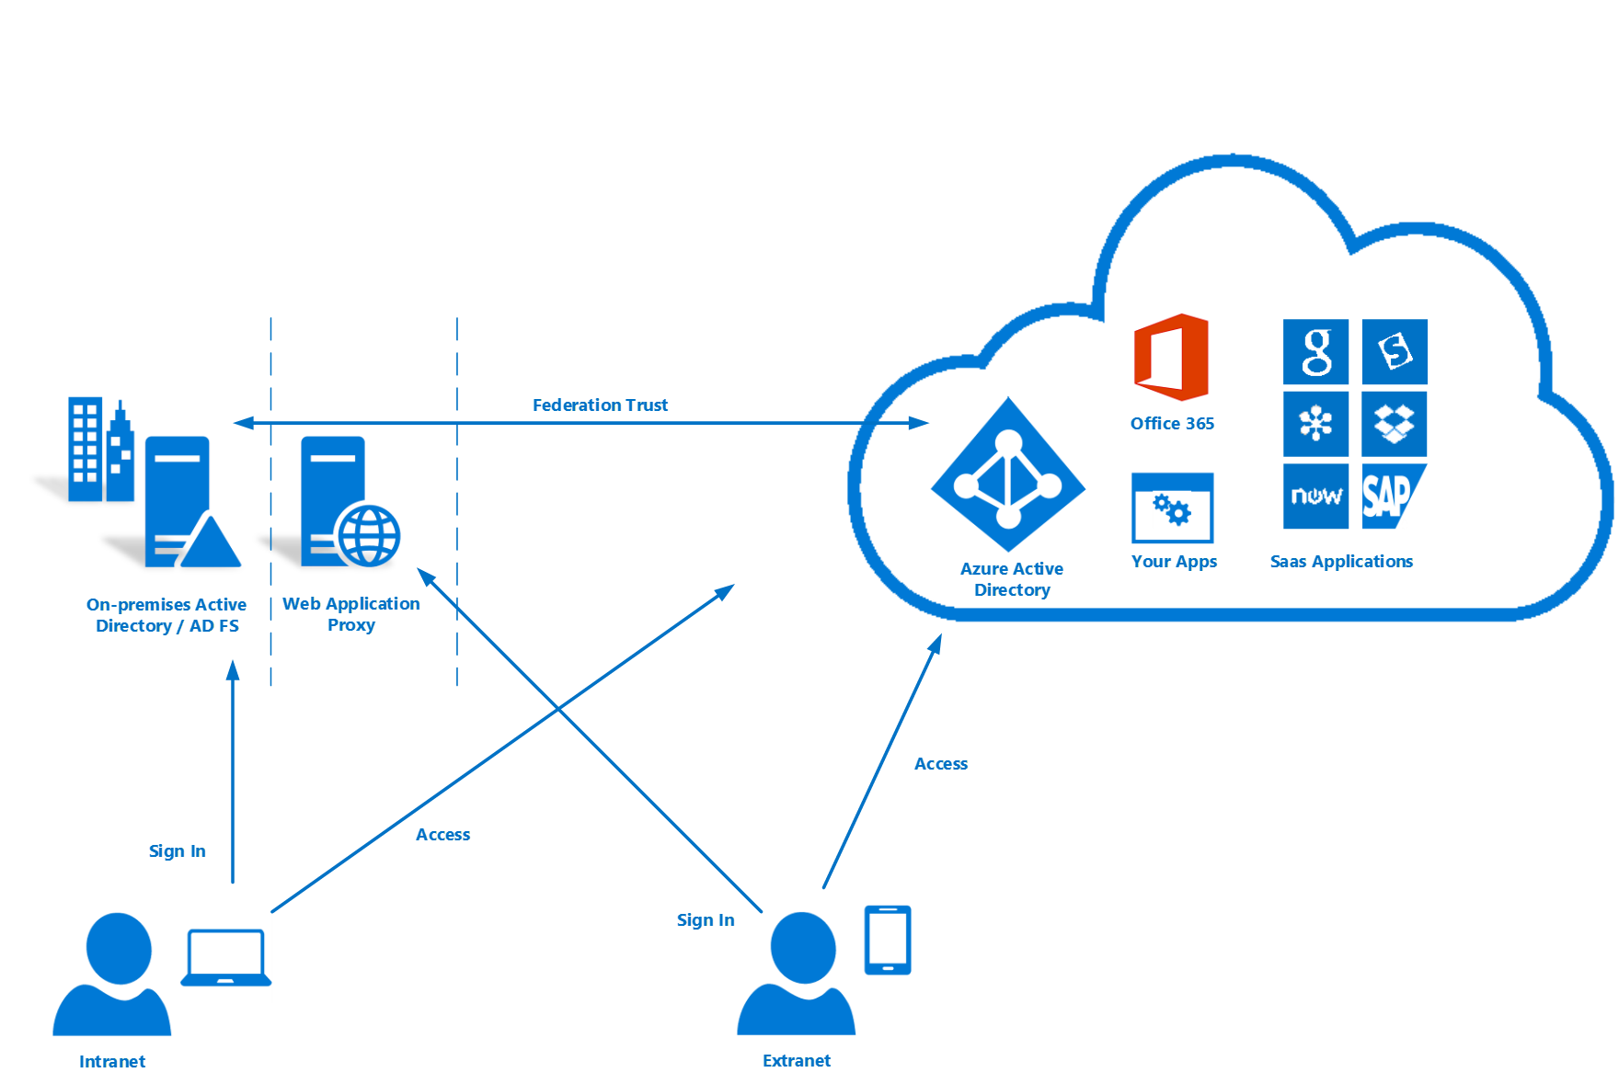
Azure AD Connect w/ADFS
Notes:
AD FS stands for Active Directory Federation Services, and it allows you to use your on-prem AD as an identity provider, so you'd be able to continue to use your on-prem AD, and it would serve as the source of truth for user identity.
Federating Azure witn your on-prem ADFS environment allows for more granular security controls such as better password policies or the ability to enforce scheduled login times.
However because it’s on-prem, it moves the management burden to your IT Staff. They must provision hardware, software, and consider Availability/DR.
Of course, you could deploy ADFS in Azure itself as long as there aren’t any network or security policies preventing it.
Reference(s):
https://docs.microsoft.com/en-us/azure/active-directory/connect/active-directory-aadconnectfed-whatis

Slide 36
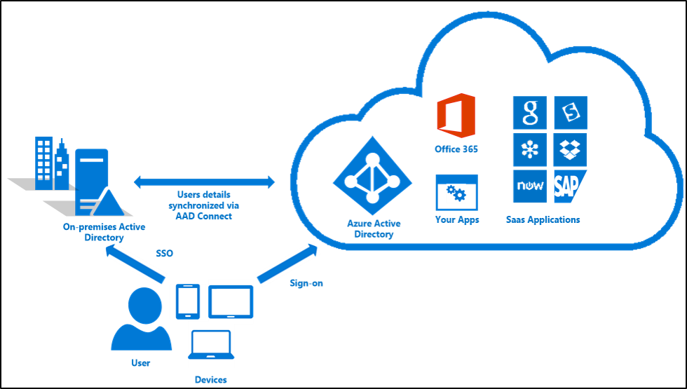
Azure AD Connect SSO
Notes:
NOT on the exam
Azure Active Directory Seamless Single Sign On (Azure AD Seamless SSO) provides true single sign on for users signing in on their corporate desktops connected on the corporate network. When enabled, users won't need to type in their passwords to sign in to Azure AD, and in most cases, even type in their usernames. This feature provides your users easy access to your cloud-based services without needing any additional on-premises components.
Seamless SSO is a free feature and you don't need any paid editions of Azure AD to use it. It remains free when the feature reaches general availability.
Supposedly GA as of 09/18/2017…not yet listed on Azure Updates page
Reference(s):
https://docs.microsoft.com/en-us/azure/active-directory/connect/active-directory-aadconnect-sso

Slide 37
AD Connect SSO - Requirements
Your user is signing in on a corporate desktop.
The desktop has been previously joined to your Active Directory (AD) domain.
The desktop has a direct connection to your Domain Controller (DC), either on the corporate wired or wireless network or via a remote access connection, such as a VPN connection.
Our service endpoints have been included to the browser's Intranet zone.
Notes:
For this feature to work for a specific user, the following conditions need to be met:
Your user is signing in on a corporate desktop.
The desktop has been previously joined to your Active Directory (AD) domain.
The desktop has a direct connection to your Domain Controller (DC), either on the corporate wired or wireless network or via a remote access connection, such as a VPN connection.
Our service endpoints have been included to the browser's Intranet zone.
If any of the above conditions are not met, then the user will be prompted to enter their username and password as before.

Slide 38
Security token:
has control of resources that are being secured
is a collection of claims
aka access token
Is digitally signed, encrypted, and transferred through secured channels
is an assertion made on an attribute of an entity
provides requested services

Slide 39
Security token:
is a collection of claims
aka access token
Is digitally signed, encrypted, and transferred through secured channels

Slide 40
Secure resources by using identity providers
Notes:
How do we share our Azure resources with external people?
How do we manage access to Azure resources by people not in our Azure AD Directory?

Slide 41
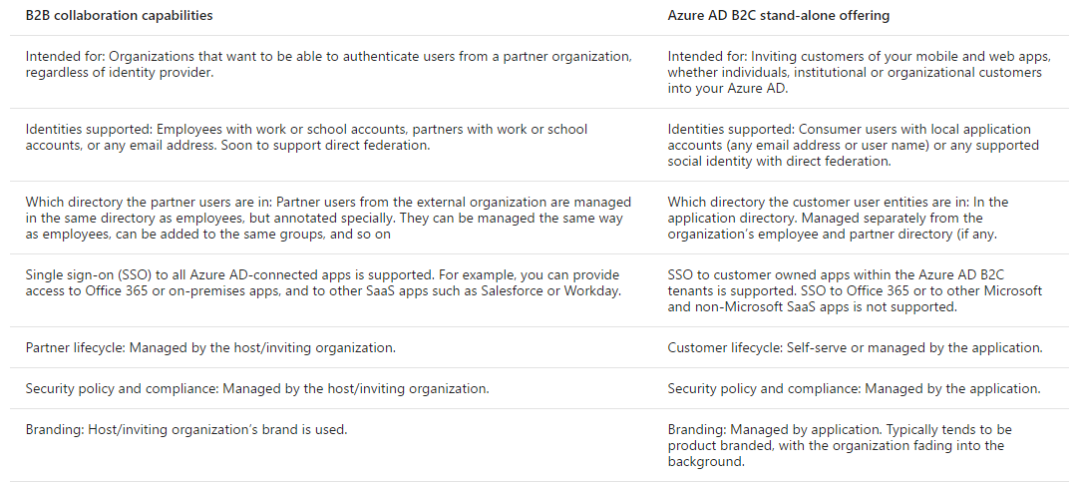
Azure AD B2B vs Azure AD B2C
Notes:
EASY TO PROVIDE ACCESS TO OTHER AZURE AD ORGS
Azure AD B2B is a feature of Azure AD called Azure AD B2B collaboration
Allows external users access to documents, resources, and applications, while owner retains complete control over their own corporate data.
Work with any user from any partner
Partners use their own credentials
No requirement for partners to use Azure AD
No external directories or complex set-up required
Simple and secure collaboration
Provide access to any corporate app or data, while applying sophisticated, Azure AD-powered authorization policies
Easy for users
Enterprise-grade security for apps and data
No management overhead
No external account or password management
No sync or manual account lifecycle management
No external administrative overhead
https://docs.microsoft.com/en-us/azure/active-directory/active-directory-b2b-what-is-azure-ad-b2b

Slide 42
Implement Azure AD B2B Collaboration
B2B collaboration allows you to invite users outside of your organization and manage access to applications and resources.
Can add invited users to:
Enterprise applications
Directory Users
Groups
If the user doesn’t have a Microsoft account or an Azure AD account – one is created for them seamlessly at the time for offer redemption.
Can utilize API to build custom application using B2B
Notes:
Implement Azure AD B2B
What is Azure AD B2B collaboration?
https://docs.microsoft.com/en-us/azure/active-directory/active-directory-b2b-what-is-azure-ad-b2b
Properties of an Azure Active Directory B2B collaboration user
https://docs.microsoft.com/en-us/azure/active-directory/active-directory-b2b-user-properties
Azure Active Directory B2B collaboration API and customization
https://docs.microsoft.com/en-us/azure/active-directory/active-directory-b2b-api
Demonstration/prototype of B2B self-service signup, signup approvals, and profile editing.
https://github.com/Azure/active-directory-dotnet-graphapi-b2bportal-web

Slide 43
You have a web application using Azure AD for its users. You now need to add users that work for a partner company. What is the easiest way to give the new external users access to your web application?
Change the web application to use a Azure B2C directory
Change your Azure AD to use the Premium edition
Invite the users from Azure AD (using Azure B2B)
Add the users to your internal Active Directory and sync
Notes:
Question

Slide 44
You have a web application using Azure AD for its users. You now need to add users that work for a partner company. What is the easiest way to give the new external users access to your web application?
Invite the users from Azure AD (using Azure B2B)
Notes:
Answer: 3

Slide 45
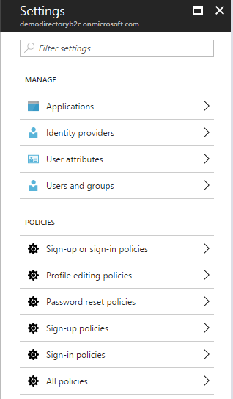
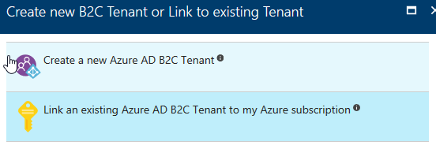
Manage Identity and access by using Azure AD B2C
Once you create Azure AD B2C, you need to link it
Allows you to add users from
Social accounts
Enterprise Accounts
Local Accounts
Can set policies
Can Brand login experience
Notes:
CAN PROVISION YOUR OWN ID PROVIDERS USING ARM TEMPLATES
CONDITIONAL ACCESS IN PREVIEW
Manage Identity and access by using Azure AD B2C
Azure Active Directory B2C: Enable Multi-Factor Authentication in your consumer-facing applications
https://docs.microsoft.com/en-us/azure/active-directory-b2c/active-directory-b2c-reference-mfa
Azure Active Directory B2C: Create an Azure AD B2C tenant
https://docs.microsoft.com/en-us/azure/active-directory-b2c/active-directory-b2c-get-started
Azure AD B2C: Focus on your app, let us worry about sign-up and sign-in
https://docs.microsoft.com/en-us/azure/active-directory-b2c/active-directory-b2c-overview

Slide 46
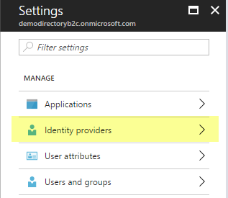
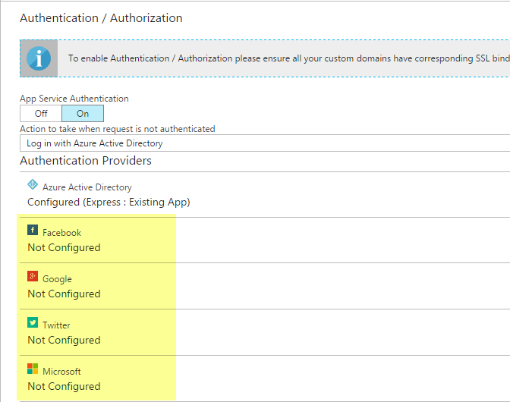
Provide access to resources using identity providers
Configure Identity Providers in Azure AD B2C
Configure in App Service Authentication blade
Notes:
Provide access to resources using identity providers, such as Microsoft Account, Facebook, Google and Yahoo!
Azure AD B2C: Focus on your app, let us worry about sign-up and sign-in
https://docs.microsoft.com/en-us/azure/active-directory-b2c/active-directory-b2c-overview
Azure Active Directory B2C: Provide sign-up and sign-in to consumers with Microsoft accounts
https://docs.microsoft.com/en-us/azure/active-directory-b2c/active-directory-b2c-setup-msa-app

Slide 47
You have a web application that needs to support Single Sign On for your on-premise users and be able to add external users using their social logins. Which product will be the best to use?
Azure AD B2C
Key Vault
Security Center
Azure B2B Collaboration
Notes:
Question

Slide 48
You have a web application that needs to support Single Sign On for your on-premise users and be able to add external users using their social logins. Which product will be the best to use?
Azure AD B2C
Notes:
Answer

Slide 49
Azure B2C allows you to add social accounts, enterprise accounts and local accounts. It is very flexible and newer than Azure AD. The exam may not call out Azure B2C or Azure B2B Collaboration, but you will need to know how to provide the solutions they solve. In preparing for the exam, you should try to explore both types of Azure AD directories and learn the pros and cons.
Notes:
The future of Azure ACS is Azure Active Directory
https://blogs.technet.microsoft.com/enterprisemobility/2015/02/12/the-future-of-azure-acs-is-azure-active-directory/

Slide 50
Identify an appropriate data security solution
Notes:
My data is in the cloud but how do I protect it?

Slide 51
Data Security and Encryption
Where is your data?
In Transit
At Rest
Security Method
MFA
RBAC
Encryption
In transit (SSL)
At Rest (Disk, File, SQL Database)
Notes:
One of the keys to data protection in the cloud is accounting for the possible states in which your data may occur, and what controls are available for that state.
At-rest: This includes all information storage objects, containers, and types that exist statically on physical media, be it magnetic or optical disk.
In-Transit: When data is being transferred between components, locations or programs, such as over the network, across a service bus (from on-premises to cloud and vice-versa, including hybrid connections such as ExpressRoute), or during an input/output process, it is thought of as being in-motion.
There are many aspects to implementing a secure environment
Enforce multi-factor authentication
Use role based access control (RBAC)
Encrypt Azure virtual machines
Use hardware security models
Manage with Secure Workstations
Enable SQL data encryption
Protect data in transit
Enforce file level data encryption
Reference(s):
https://docs.microsoft.com/en-us/azure/security/azure-security-data-encryption-best-practices

Slide 52
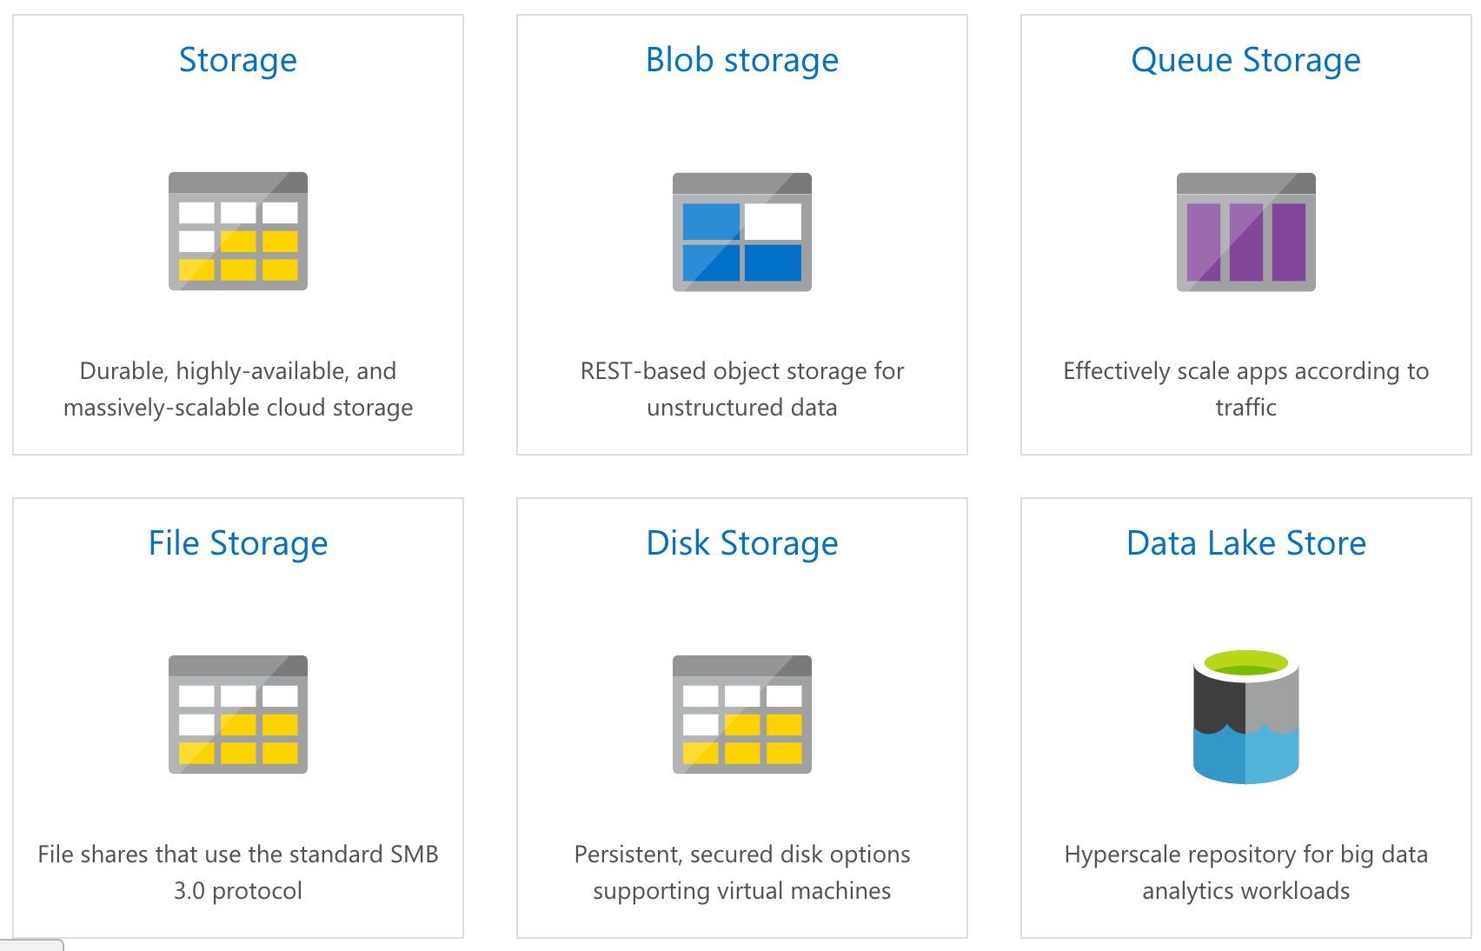
Azure Storage
Notes:
Azure Storage Service is a single service with different types of storage including options for Object, Table, Disk and Queue storage.
Currently, Azure allows the encryption of blobs using a managed form of encryption. Azure will seamlessly encrypt the data before persisting it and decrypt it before reading it and you can enable this feature with a toggle switch and then anything that's newly added is going to be encrypted, and if you were to disable encryption then similarly to before, anything newly added won't be encrypted. And it's important to note this functionality is only for the Resource Manager storage accounts, not the classic so that toggle is going to handle data at rest for blob storage. For data in transit, you can use https. For the other storage options, you'll want to use the https option for in transit. However, for data at rest, you're going to have to bring your own solution.
Reference(s):
https://docs.microsoft.com/en-us/azure/security/azure-security-data-encryption-best-practices

Slide 53
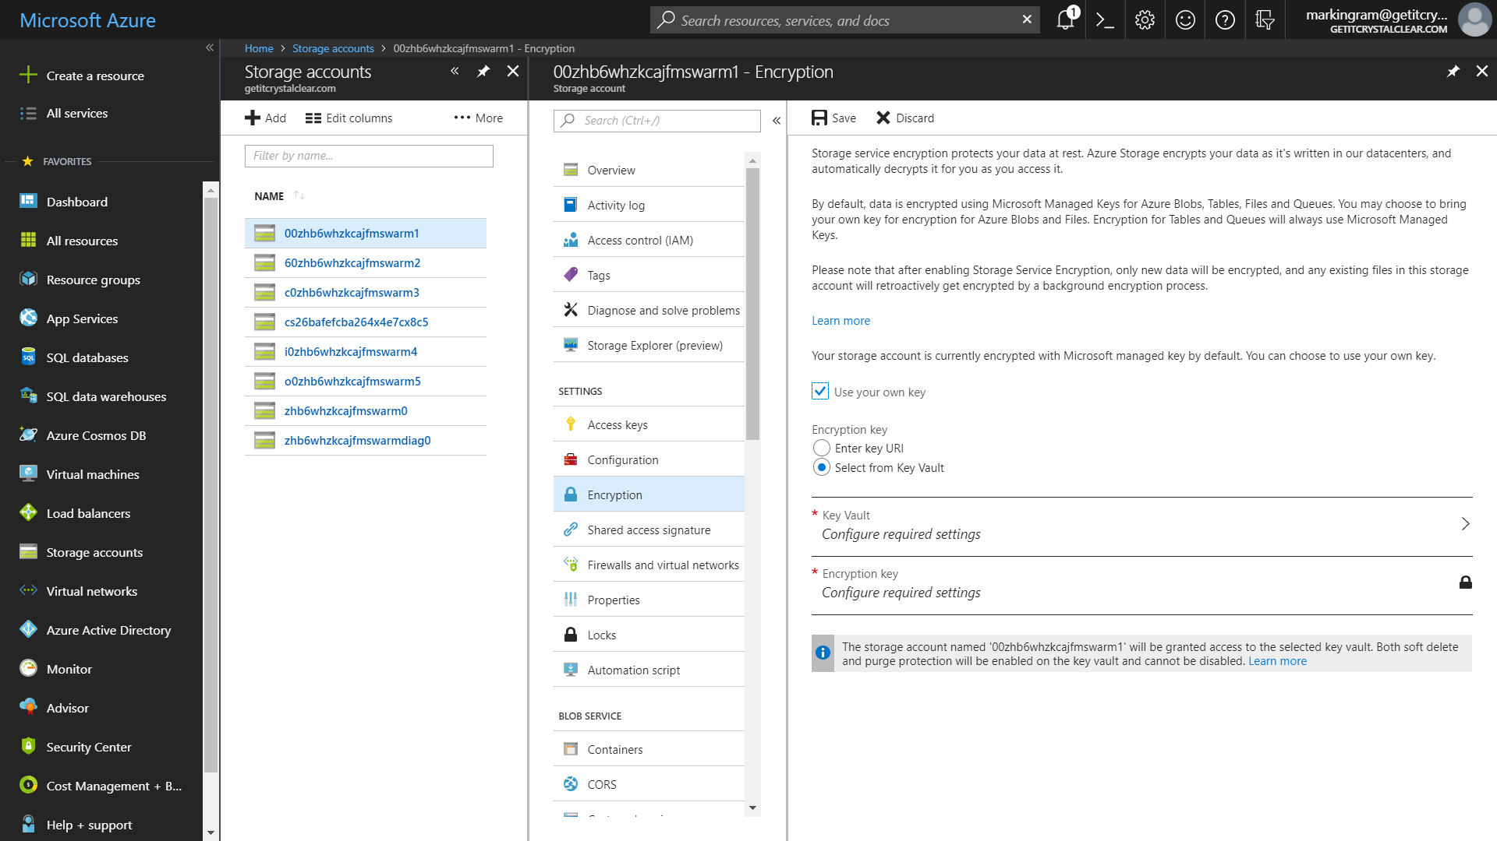
Storage Services Encryption
Notes:
HARDWARE KEY VAULT WILL BE ANNOUNCED AT IGNITE 2018
DEFAULT NOW IS ENCRYPTED
SSE APPLIES ACROSS ENTIRE ACCOUNT
YOU CAN USE YOUR OWN KEY
Azure Storage Service Encryption (SSE) for Data at Rest helps you protect and safeguard your data to meet your organizational security and compliance commitments. With this feature, Azure Storage automatically encrypts your data prior to persisting to storage and decrypts prior to retrieval. The encryption, decryption, and key management are totally transparent to users.
SSE works by encrypting the data when it is written to Azure Storage, and can be used for Azure Blob Storage and File Storage. It works for the following:
Standard Storage: General purpose storage accounts for Blobs and File storage and Blob storage accounts
Premium storage
All redundancy levels (LRS, ZRS, GRS, RA-GRS)
Azure Resource Manager storage accounts (but not classic)
All regions.

Slide 54
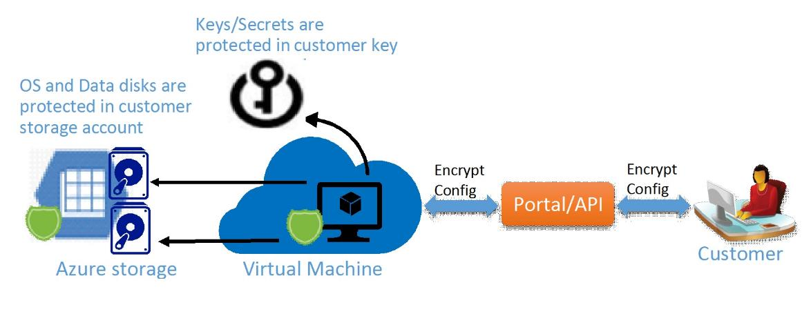
Azure Disk Encryption
Notes:
THE PLATFORM DOESN’T KNOW WHAT THE KEY IS. IT JUST KNOWS HOW TO DECRYPT.
Azure Disk Encryption is a new capability that helps you encrypt your Windows and Linux IaaS virtual machine disks. Azure Disk Encryption leverages the industry standard BitLocker feature of Windows and the DM-Crypt feature of Linux to provide volume encryption for the OS and the data disks. The solution is integrated with Azure Key Vault to help you control and manage the disk-encryption keys and secrets in your key vault subscription. The solution also ensures that all data on the virtual machine disks are encrypted at rest in your Azure storage.
Azure disk encryption for Windows and Linux IaaS VMs is now in General Availability in all Azure public regions and AzureGov regions for Standard VMs and VMs with premium storage.
When you apply the Azure Disk Encryption-management solution, you can satisfy the following business needs:
IaaS VMs are secured at rest, because you can use industry-standard encryption technology to address organizational security and compliance requirements.
IaaS VMs boot under customer-controlled keys and policies, and you can audit their usage in your key vault.

Slide 55
Azure Disk Encryption Scenarios
Enable encryption on new IaaS VMs created from pre-encrypted VHD and encryption keys
Enable encryption on new IaaS VMs created from the Azure Gallery images
Enable encryption on existing IaaS VMs running in Azure
Disable encryption on Windows IaaS VMs
Disable encryption on data drives for Linux IaaS VMs
Enable encryption of managed disk VMs
Update encryption settings of an existing encrypted non-premium storage VM
Backup and restore of encrypted VMs, encrypted with key encryption key
Notes:
For the test, you should be able to know how (and why) you would want to implement each of these scenarios.

Slide 56
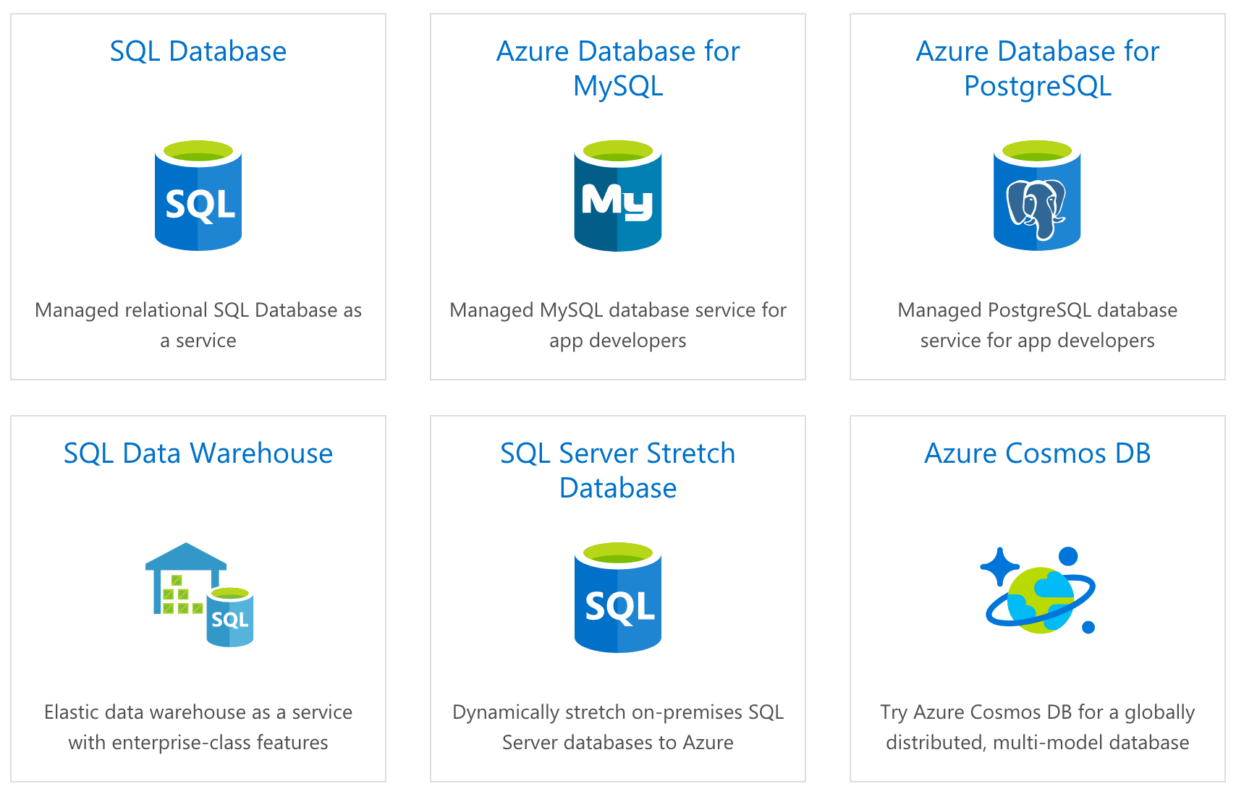
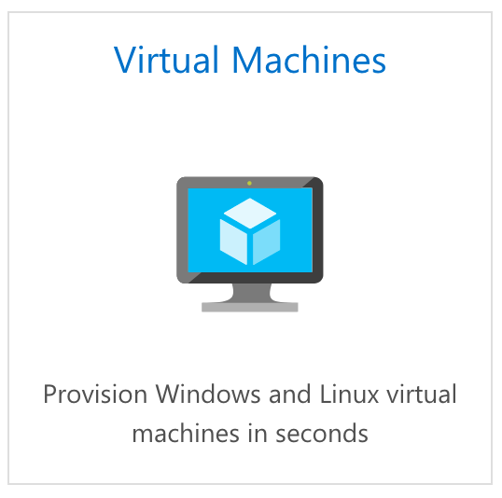
Azure Databases
Notes:
Mention SQL Server running on a VM in addition to the PAAS solutions.
It's not uncommon for solutions architects who are building out HIPAA compliant applications or apps that are similar with their security requirements to require encryption for the data that's in transit and at rest.

Slide 57
SQL Server TDE
Transparent Data Encryption
Applies to both PAAS and IAAS offerings
Covers both “in transit” and “at rest” encryption requirements
Notes:
So to facilitate that, SQL Server has a feature called Transparent Data Encryption abbreviated TDE. What it does is it encrypts the database, associated backups and transaction log files behind the scenes and allows us as developers to query the database without any changes to our code. So TDE is going to cover data at rest for SQL and for in transit, you'll want to use SSL with whatever libraries the developers are actually using.
When it comes to hosting SQL Server, you can go the platform as a service route and use Azure SQL and in that case, it's going to easily allow you to enable TDE via the portal, PowerShell or T-SQL or you could host it yourself either on-prem or with IaaS VMs and in that case, you can enable TDE. However, you also have more responsibility for securing the server, backups and everything else.

Slide 58
Azure Storage Client Library
Encrypting data within client applications before uploading to Azure Storage
Decrypting data while downloading to the client
Integrates with Azure Key Vault for storage account key management
Notes:
https://docs.microsoft.com/en-us/azure/storage/storage-client-side-encryption
The storage client library uses AES in order to encrypt user data. Specifically, Cipher Block Chaining (CBC) mode with AES.

Slide 59
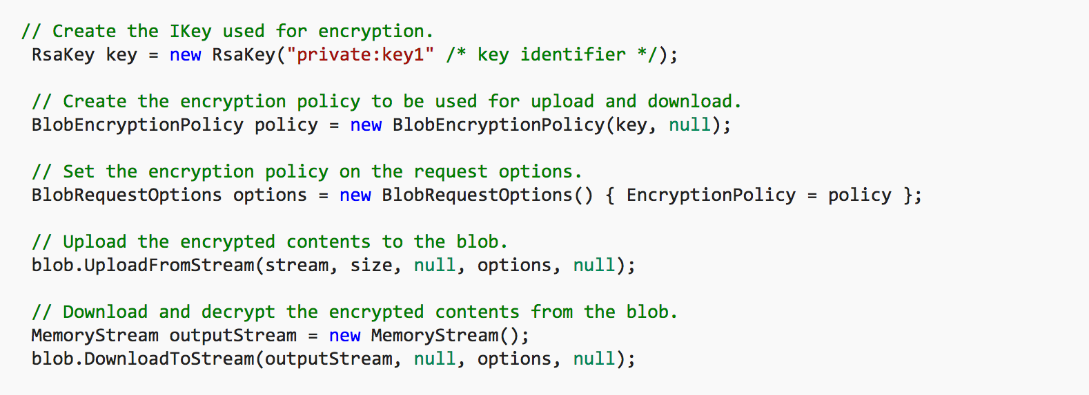
Azure Storage Client Library – Blob Example
Notes:
Create a BlobEncryptionPolicy object and set it in the request options (per API or at a client level by using DefaultRequestOptions). Everything else will be handled by the client library internally.

Slide 60
Azure Storage costs more if Storage Service Encryption SSE is enabled
True
False
Notes:
Question

Slide 61
Azure Storage costs more if Storage Service Encryption SSE is enabled
False
Notes:
Answer

Slide 62
Azure Storage provides a comprehensive set of security capabilities which together enable developers to build secure applications. These options include:
Securing your Storage Account
Securing Access to Your Data
Encryption in Transit
Encryption at Rest
Storage Analytics to audit access of Azure Storage
Notes:
Question

Slide 63
Azure Storage provides a comprehensive set of security capabilities which together enable developers to build secure applications. These options include:
Securing your Storage Account
Securing Access to Your Data
Encryption in Transit
Encryption at Rest
Storage Analytics to audit access of Azure Storage
Notes:
Question

Slide 64
Design a role-based access control (RBAC) strategy
Notes:
How do I control access to my Azure resources?

Slide 65
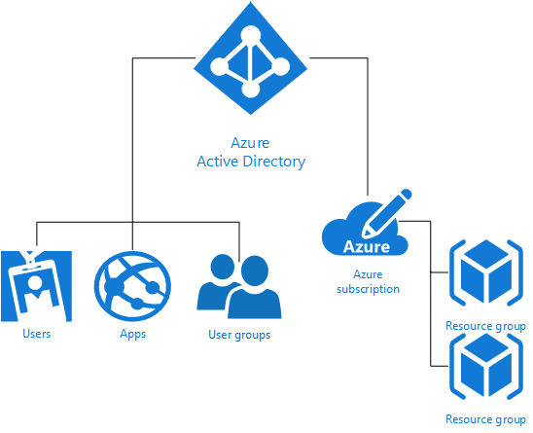
RBAC Overview
Notes:
Each Azure subscription is associated with one Azure Active Directory (AD) directory. Users, groups, and applications from that directory can manage resources in the Azure subscription. Assign these access rights using the Azure portal, Azure command-line tools, and Azure Management APIs. Multiple subscriptions can trust the same directory, but each subscription trusts only one directory.
Grant access by assigning the appropriate RBAC role to users, groups, and applications at a certain scope. The scope of a role assignment can be a subscription, a resource group, or a single resource. A role assigned at a parent scope also grants access to the children contained within it. For example, a user with access to a resource group can manage all the resources it contains, like websites, virtual machines, and subnets.
Using RBAC, you can segregate duties within your team and grant only the amount of access to users that they need to perform their jobs. Instead of giving everybody unrestricted permissions in your Azure subscription or resources, you can allow only certain actions. For example, use RBAC to let one employee manage virtual machines in a subscription, while another can manage SQL databases within the same subscription.
The trust relationship that a subscription has with a directory is unlike the relationship that it has with other resources in Azure (websites, databases, and so on). If a subscription expires, access to the other resources associated with the subscription also stops. But an Azure AD directory remains in Azure, and you can associate a different subscription with that directory and manage the directory using the new subscription.
Reference(s):
https://docs.microsoft.com/en-us/azure/active-directory/active-directory-how-subscriptions-associated-directory
https://docs.microsoft.com/en-us/azure/active-directory/role-based-access-control-configure

Slide 66
Role Management
Levels at which may be managed/assigned
Subscription Level
Resource Group Level
Resource Level
Built-In roles
Custom Roles
Access that you grant at parent scopes is inherited at child scopes
Notes:
Azure allows us to manage where a role is assigned, and there are three locations. At the subscription level, at a resource group level, or on a resource directly.
Now, the word resource tells us that this is all handled from the new portal or from PowerShell, the command line interface, or the REST API. Since the classic Portal is about services, and the new Portal is all about resources. Azure gives us a set of common built-in roles that we can use.
The list is fairly long, you can find it at https://docs.microsoft.com/en-us/azure/active-directory/role-based-access-built-in-roles
You assign the Reader role to an Azure AD group at the subscription scope. The members of that group can view every resource group and resource in the subscription.
You assign the Contributor role to an application at the resource group scope. It can manage resources of all types in that resource group, but not other resource groups in the subscription.
Becoming less of an issue, but worth pointing out for the exam:
Only the Azure portal and the new Azure Resource Manager APIs support Azure RBAC. Users and applications that are assigned RBAC roles cannot use the classic management portal and the Azure classic deployment model.
Reference(s):
https://docs.microsoft.com/en-us/azure/active-directory/role-based-access-control-what-is

Slide 67
Custom Roles
Use when none of the built-in roles meet your needs
Each tenant can create up to 2000 custom roles.
Shared across all subscriptions that use a tenant
Comprised of Actions, NotActions, and AvailableScopes
Managed via Portal, PowerShell, Azure CLI, or the REST API
Notes:
Azure allows us to manage where a role is assigned, and there are three locations. At the subscription level, at a resource group level, or on a resource directly.
Azure RBAC has three basic roles that apply to all resource types:
Owner has full access to all resources including the right to delegate access to others.
Contributor can create and manage all types of Azure resources but can’t grant access to others.
Reader can view existing Azure resources.
Now, the word resource tells us that this is all handled from the new portal or from PowerShell, the command line interface, or the REST API. Azure gives us a set of common built-in roles that we can use.
The list is fairly long, you can find it at https://docs.microsoft.com/en-us/azure/active-directory/role-based-access-built-in-roles
Any time someone grants or revokes access within your subscriptions, the changes get logged in Azure events. You can create access change history reports to see all changes for the past 90 days.

Slide 68
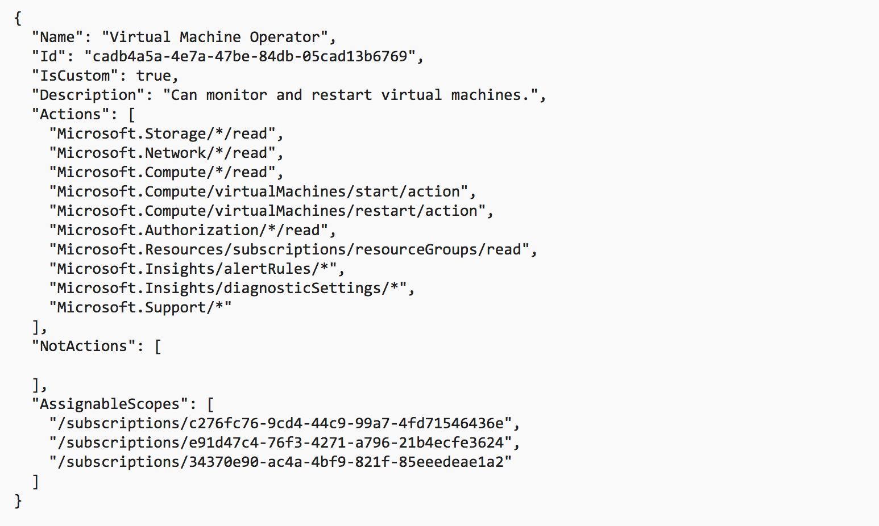
Custom Role Example
Notes:
This is an example of a custom role for monitoring and restarting virtual machines:

Slide 69
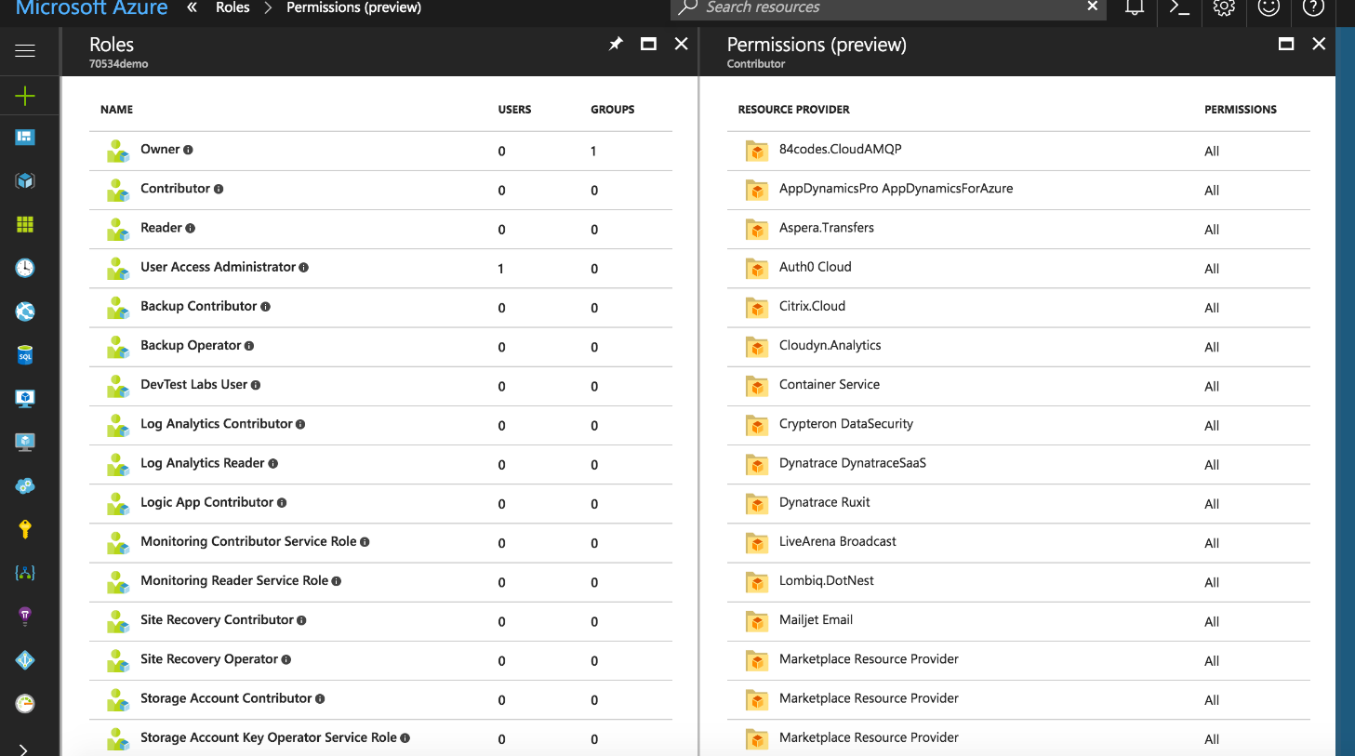
RBAC in the Azure Portal

Slide 70
Manage security risks by using an appropriate security solution
Notes:
How do I KNOW my Azure environment is secure?

Slide 71
CIA-Triad Security Model
Confidentiality: Prevention of unauthorized access to system
Integrity: Prevention of unauthorized modification of system
Availability: Prevention of disruption of service/availability of system
Notes:
Anyone who has is familiar with computer security has likely come across the CIA triad.
In order for a system to be considered ‘secure’ it must embrace these three concepts.

Slide 72
Shared Security Responsibility Model
Microsoft Azure is your security partner
Security responsibilities depend on delivery model
Vulnerabilities are portable!
Azure “security toolbox”
Operations Management Suite (OMS)
Activity Log
Azure Security Center (ASC)
Notes:
Azure, like most of the public cloud providers, subscribes to the Shared Security Responsibility model.
MSFT has a great deal of security around its services and does a fantastic job protecting those, but it does not automatically protect your services/applications.
To aid the client in implementing and security their services, Azure provides a set of tools aid in securing your services and applications.
Obviously these resources and tools are only part of the story. For example, an application with a SQL injection vulnerability will be just as vulnerable in Azure as it would be on Prem. Azure has no way to detect and protect against such a situation.
Long story short: Cloud providers offer considerable advantages for security and compliance efforts, but these advantages do not absolve the customer from protecting their users, applications, and service offerings.
3-main tools
- OMS
- Activity Log
- Azure Security Center
Thus, it’s not a magic bullet and we all have to do our part in building secure applications.
References:
Blog Post: Alice Rison Senior Director, Microsoft Azure - Microsoft Incident Response and shared responsibility for cloud computing
https://azure.microsoft.com/en-us/blog/microsoft-incident-response-and-shared-responsibility-for-cloud-computing/

Slide 73
Operations Management Suite
Single integration/control point for Azure Services
Integrates with 3rd party services from marketplace
Anything with an agent
Provides operational intelligence across hybrid environments
Process automation and monitoring of resources
Cloud-based SaaS (thus highly available)
Protects privacy and security of data, while delivering software and services to manage the IT infrastructure.
Notes:
GOOD FOR TRIAGING AND BEING PROACTIVE
What is it?
Cloud-based Single pane of glass
Directly integrates with Azure services
Integrates with 3rd party services (Barracuda Firewall, Sophos, WAF, etc..) from Azure marketplace
Also includes an agent
Cross platform
Provides enterprise-class, real-time operational intelligence across hybrid environments
View and monitor your on-prem and cloud resources within a single portal
Simplifies cloud management with process automation and monitoring of resources
Cloud Based, thus ensures preparedness in the event of a disaster with cloud-based availability
Protects privacy and security of data, while delivering software and services to manage the IT infrastructure.
Reference(s):
https://docs.microsoft.com/en-us/azure/operations-management-suite/operations-management-suite-overview

Slide 74
Operations Management Suite
Notes:
OMS is capable of integrating data from multiple sources including
Azure
AWS or other Public Clouds (Google Compute, Heroku, etc)
Private (on-prem) Clouds
On-Prem resources
Cross platform

Slide 75
Operations Management Suite
Log Analytics
Central monitoring and analysis of logs from multiple sources
Automation
Process automation
Configuration enforcement
Backup
Backup and restore critical data
Site Recovery
High availability for critical applications
Notes:
The core functionality of OMS is provided by a set of services that run in Azure.
Log Analytics
Push your logs into a central repository
Data could be service events, performance data, or custom data
Data is then available for consumption by multiple endpoints
Alerts – Which could then trigger a runbook
Dashboards
Export
APIs
Automation
Automate manual processes (runbooks) via PowerShell scripts and workflows
Easily manage resources running in the cloud
Use Hybrid Runbook workers for on-prem
Enforce the configuration of physical/virtual machines via PowerShell DSC
Works in cloud
Works on-prem via PS DSC Agents
Backups
OMS utilizes Azure Backup for backup and restore services (wont get into all the scenarios)
Site Recovery
Azure Site Recovery orchestrates the replication of on-prem virtual/physical machines to Azure or a secondary DR site
Again, won’t go into details but know that it exists and you should review its contribution to the OMS ecosystem
Management solutions
Utilizes one or more OMS service to provide a pre-packaged management scenario
Example: Update management (scan update logs to identify resources with missing updates)
Reference(s):
https://docs.microsoft.com/en-us/azure/operations-management-suite/operations-management-suite-overview\
http://azure.microsoft.com/documentation/services/log-analytics
https://docs.microsoft.com/en-us/azure/automation/automation-intro
http://azure.microsoft.com/documentation/services/backup
http://azure.microsoft.com/documentation/services/site-recovery

Slide 76
Operations Management Suite
Integrating OMS
Workspace in Azure
Multiple Connection Methods
OMS agent installed directly on Windows/Linux host
SCOM
Azure diagnostic VM extension storage account
Notes:
Internals – How does it work – What’s needed
OMS Workspace: A workspace is a logical container where your management data is stored. It provides you a way to partition data between different teams in your organization, as the data is exclusive to its workspace.
Connection Method: Define the connection method OMS will use for data collection
Agent installed on a server
SCOM
Azure storage account configured with the Windows or Linux Azure diagnostic VM extension (option when provisioning new VM) or under Diagnostics settings of the VM blade
References:
http://download.microsoft.com/download/3/7/E/37E21FFE-7E3B-4EB3-A0FE-A07E66ECB9F9/Microsoft_Operations_Management_Suite_Resources.pdf

Slide 77
Activity Log
Provides visibility into subscription-level activity (control-plane)
Information about operations performed ON resources not WITHIN
Answers the question: “What, Who, and When?”
Azure Resource Manager operational data
Service Health events/updates
Limited to Azure Infrastructure and Services
Cannot provide information about OS or custom application events
Differ from resource-level diagnostic logs
Notes:
Answers the question: Who turned off the SQL server!?
Does not answer the question “What caused the SQL server to restart?”
Activity Logs can then feed into a number of downstream entities
OMS Log Analytics
EventHub
PowerBI
Azure Storage
Reference(s):
https://docs.microsoft.com/en-us/azure/monitoring-and-diagnostics/monitoring-overview-activity-logs

Slide 78
Activity vs. Diagnostic Logs
Notes:
The Azure Activity Log is a subscription log that provides insight into subscription-level events that have occurred in Azure. This includes a range of data, from Azure Resource Manager operational data to updates on Service Health events. The Activity Log was previously known as “Audit Logs” or “Operational Logs,” since the Administrative category reports control-plane events for your subscriptions. Using the Activity Log, you can determine the ‘what, who, and when’ for any write operations (PUT, POST, DELETE) taken on the resources in your subscription. You can also understand the status of the operation and other relevant properties. The Activity Log does not include read (GET) operations
Categories in the Activity Log
The Activity Log contains several categories of data. For full details on the schemata of these categories, see this article. These include:
Administrative - This category contains the record of all create, update, delete, and action operations performed through Resource Manager. Examples of the types of events you would see in this category include "create virtual machine" and "delete network security group" Every action taken by a user or application using Resource Manager is modeled as an operation on a particular resource type. If the operation type is Write, Delete, or Action, the records of both the start and success or fail of that operation are recorded in the Administrative category. The Administrative category also includes any changes to role-based access control in a subscription.
Service Health - This category contains the record of any service health incidents that have occurred in Azure. An example of the type of event you would see in this category is "SQL Azure in East US is experiencing downtime." Service health events come in five varieties: Action Required, Assisted Recovery, Incident, Maintenance, Information, or Security, and only appear if you have a resource in the subscription that would be impacted by the event.
Alert - This category contains the record of all activations of Azure alerts. An example of the type of event you would see in this category is "CPU % on myVM has been over 80 for the past 5 minutes." A variety of Azure systems have an alerting concept -- you can define a rule of some sort and receive a notification when conditions match that rule. Each time a supported Azure alert type 'activates,' or the conditions are met to generate a notification, a record of the activation is also pushed to this category of the Activity Log.
Autoscale - This category contains the record of any events related to the operation of the autoscale engine based on any autoscale settings you have defined in your subscription. An example of the type of event you would see in this category is "Autoscale scale up action failed." Using autoscale, you can automatically scale out or scale in the number of instances in a supported resource type based on time of day and/or load (metric) data using an autoscale setting. When the conditions are met to scale up or down, the start and succeeded or failed events are recorded in this category.
Recommendation - This category contains recommendation events from Azure Advisor.
Security - This category contains the record of any alerts generated by Azure Security Center. An example of the type of event you would see in this category is "Suspicious double extension file executed."
Policy and Resource Health - These categories do not contain any events; they are reserved for future use.
Limited to Azure Infrastructure and Services
Cannot provide information about OS or custom application events
Reference(s):
https://docs.microsoft.com/en-us/azure/monitoring-and-diagnostics/monitoring-overview-activity-logs

Slide 79
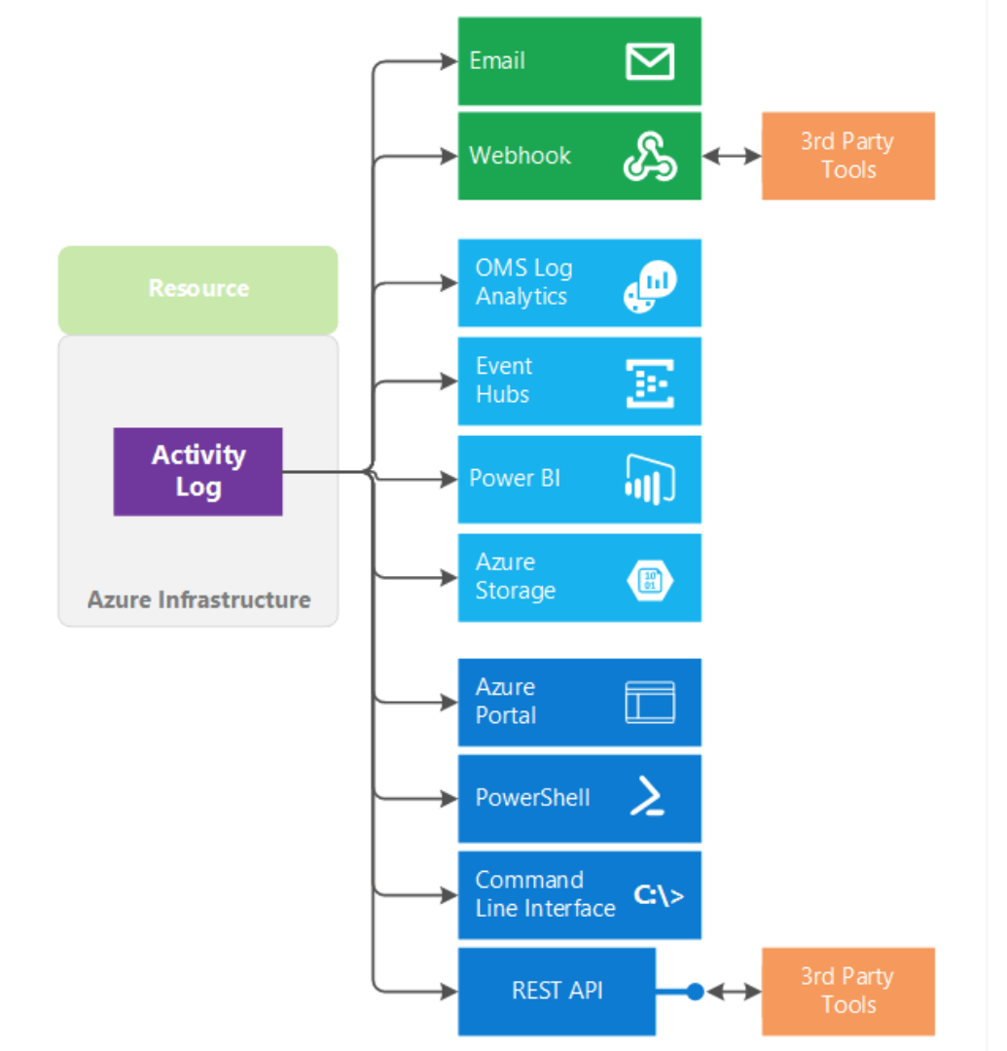

Slide 80
Azure Security Center
Provides a central view of security state
Azure resources
On-Premises
Other clouds
Unified Visibility and Control
Define security configuration policies
Monitor policy adherance
Adaptive Threat Prevention
Continuous security assessment
Threat detection
Notes:
As we all know, security in any environment is a challenge and to some extent because the cloud removes the physicality of our infrastructure, it becomes even more so.
Azure Security Center provides unified security management and advanced threat protection for workloads running in Azure, on-premises, and in other clouds. It delivers visibility and control over hybrid cloud workloads, active defenses that reduce your exposure to threats, and intelligent detection to help you keep pace with rapidly evolving cyberattacks.
Azure security center enables you to stay ahead of threats by tapping into Microsoft’s own security apparatus.
Reference(s):
https://docs.microsoft.com/en-us/azure/security-center/security-center-intro
https://docs.microsoft.com/en-us/azure/security-center/security-center-get-started
https://docs.microsoft.com/en-us/azure/monitoring-and-diagnostics/monitoring-overview-of-diagnostic-logs

Slide 81
Azure Security Center
Notes:
CAN APPLY SECURITY POLICY TO SUBSCRIPTION, RESOURCE GROUP, ETC
JUST IN TIME VM ACCESS—CAN USE AN APPROVAL WORKFLOW. CREATES AN NSG RULE TO ALLOW ACCESS FOR AN HOUR, FOR EXAMPLE.

Slide 82
Azure Security Center

Slide 83
Azure Security Center
Notes:
https://docs.microsoft.com/en-us/azure/security-center/security-center-get-started
Recommendations view
Recommendations based on data collected by agent and MSFT rules

Slide 84
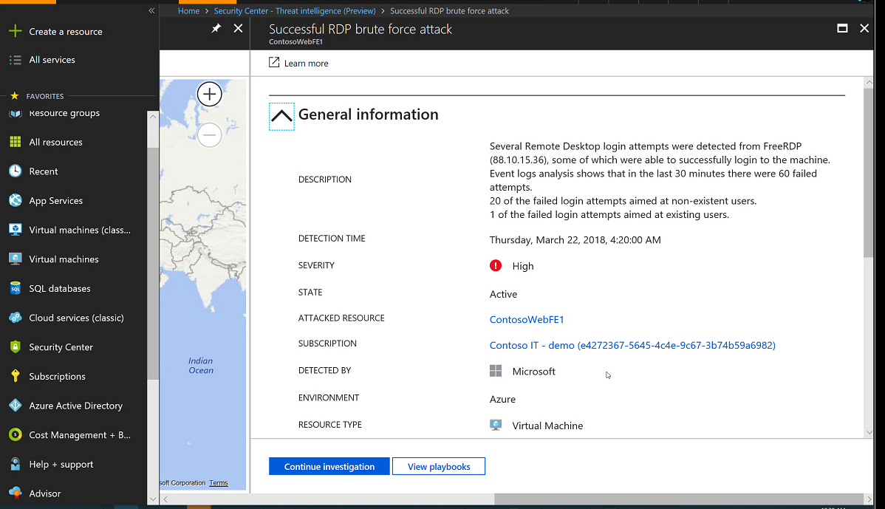

Slide 85
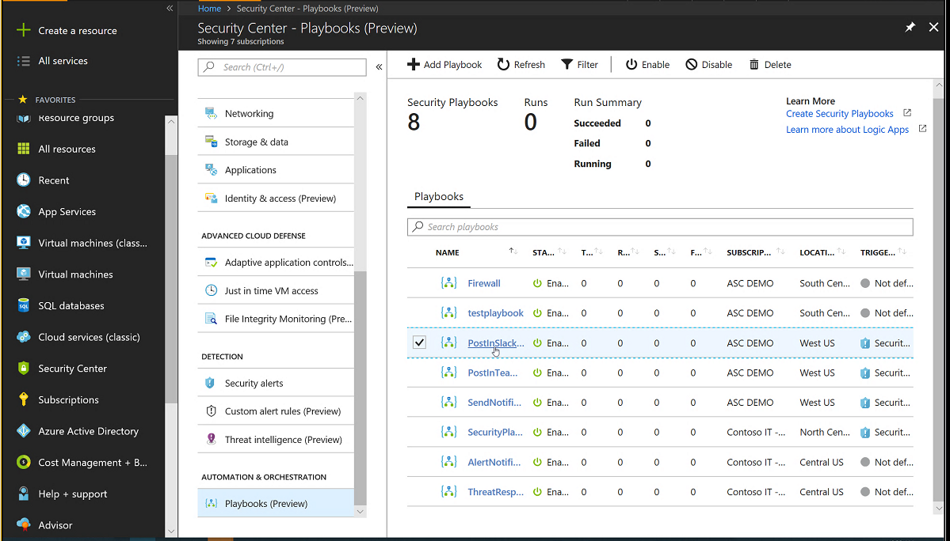

Slide 86
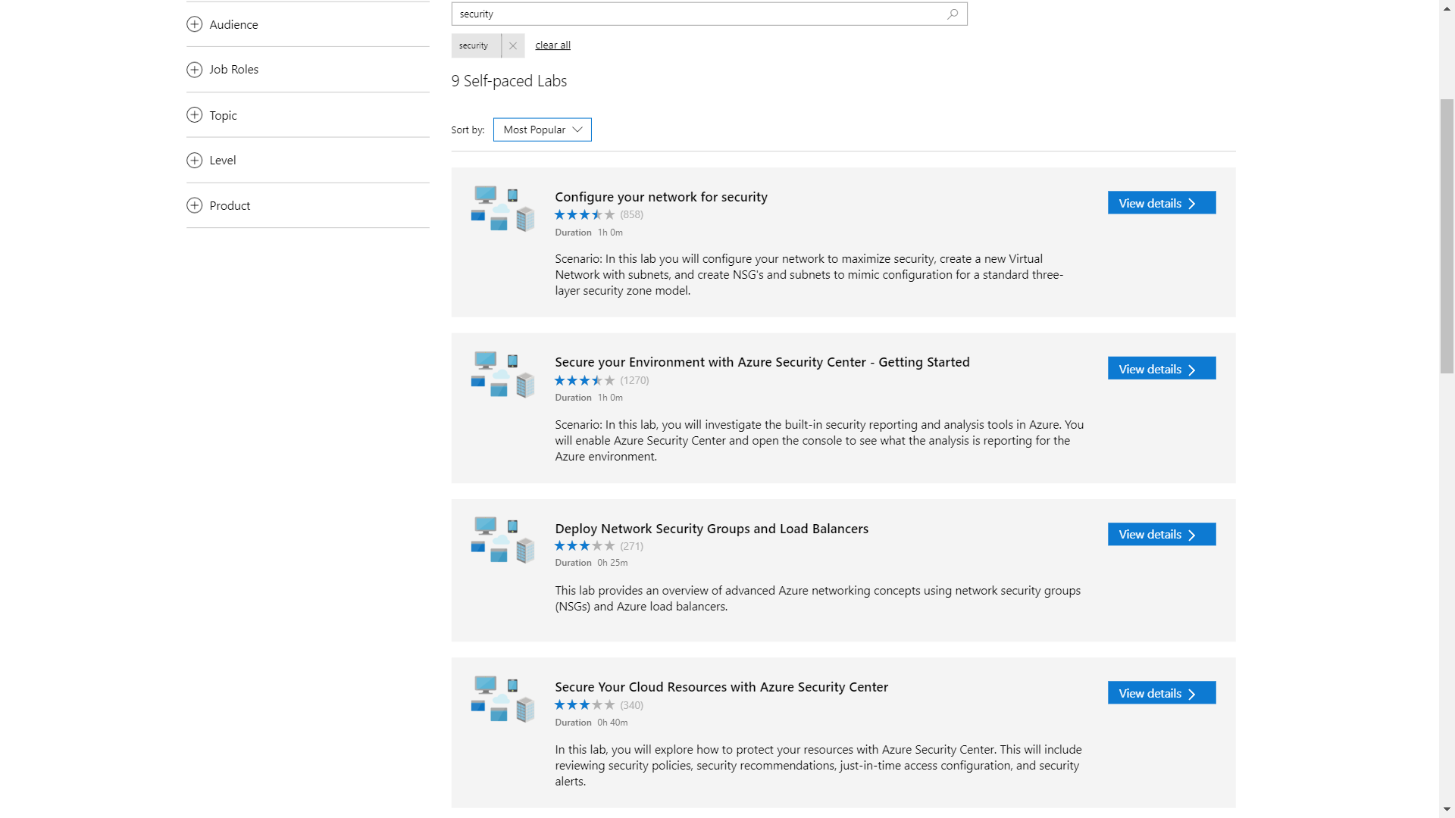
Notes:
https://www.microsoft.com/handsonlabs/SelfPacedLabs#keywords=security&page=1&sort=Most%20Popular

Slide 87
Which Azure component allows you to monitor security across on-premises and cloud workloads
Advanced analytics
Azure Security Center
RBAC Monitor
SCOM
Notes:
Question

Slide 88
Which Azure component allows you to monitor security across on-premises and cloud workloads
Azure Security Center
Notes:
Question

Slide 89
Securing Resources
Managed Identities
Hybrid Identities
Identity Providers
Data Security
RBAC

